Slide 1
Principles of Artificial Intelligence (CS0303)
Introduction to A.I

Slide 2




Outline
1
AI: Fiction vs. Reality
2
What is AI?
3
Foundations and History of AI
4
AI: State of the Art

Slide 3



Outline
1
AI: Fiction vs. Reality
2
What is AI?
3
Foundations and History of AI
4
AI: State of the Art

Slide 4
AI in Fiction
There is plenty of AI in fiction ...

Slide 5
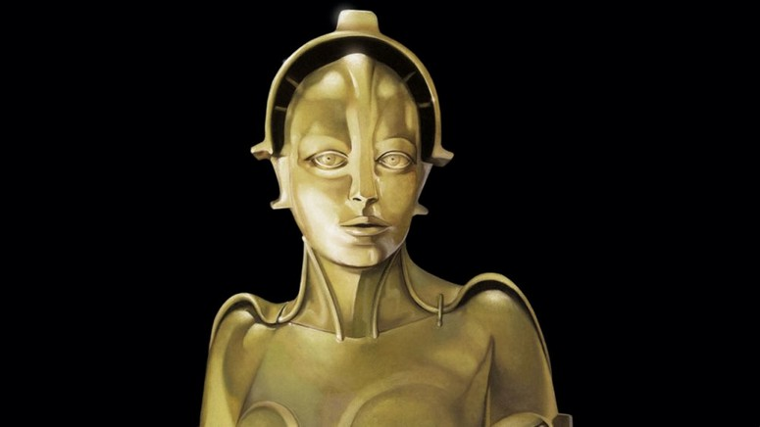
AI in Fiction
“Metropolis”, 1927, by Fritz Lang
... and many others ...

Slide 6
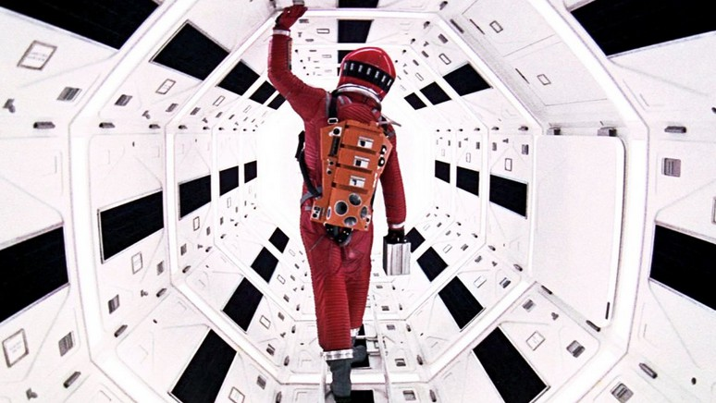
AI in Fiction
“2001, Space Odyssey”, 1968, by Stanley Kubrick
... and many others ...
5 / 39

Slide 7
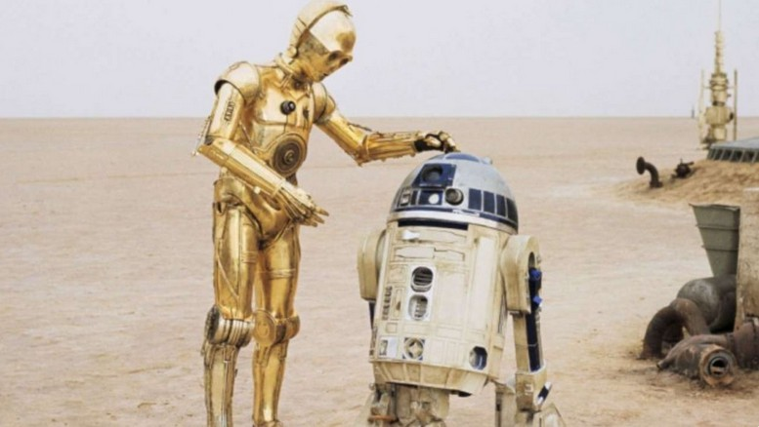
AI in Fiction
“Star Wars”, 1977, by George Lucas
... and many others ...
5 / 39

Slide 8
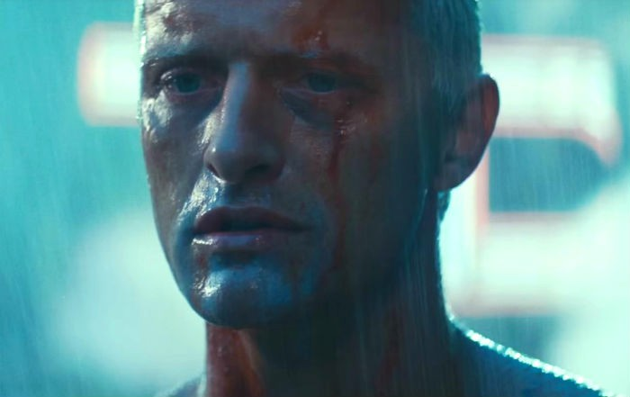
AI in Fiction
“Blade Runner”, 1982, by Ridley Scott
... and many others ...
5 / 39

Slide 9
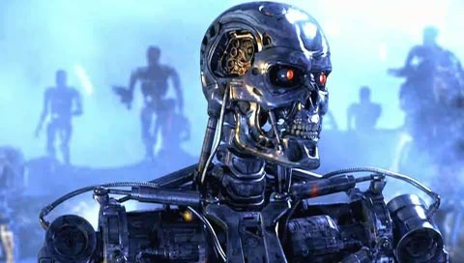
AI in Fiction
“Terminator”, 1984, by James Cameron
... and many others ...
5 / 39

Slide 10
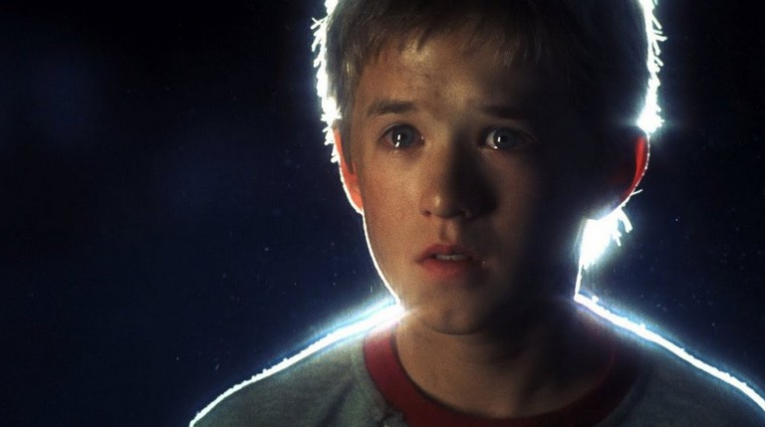
AI in Fiction
“A.I., Artificial Intelligence”, 2001, by Steven Spielberg
... and many others ...
5 / 39

Slide 11
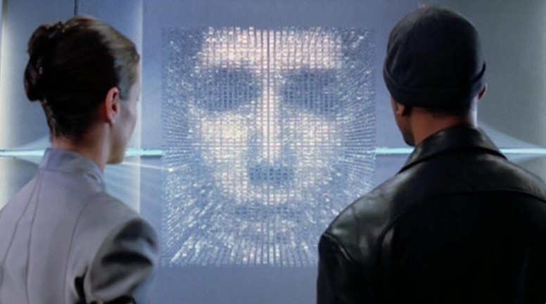
AI in Fiction
“I, Robot”, 2004, by Alex Proyas
... and many others ...
5 / 39

Slide 12
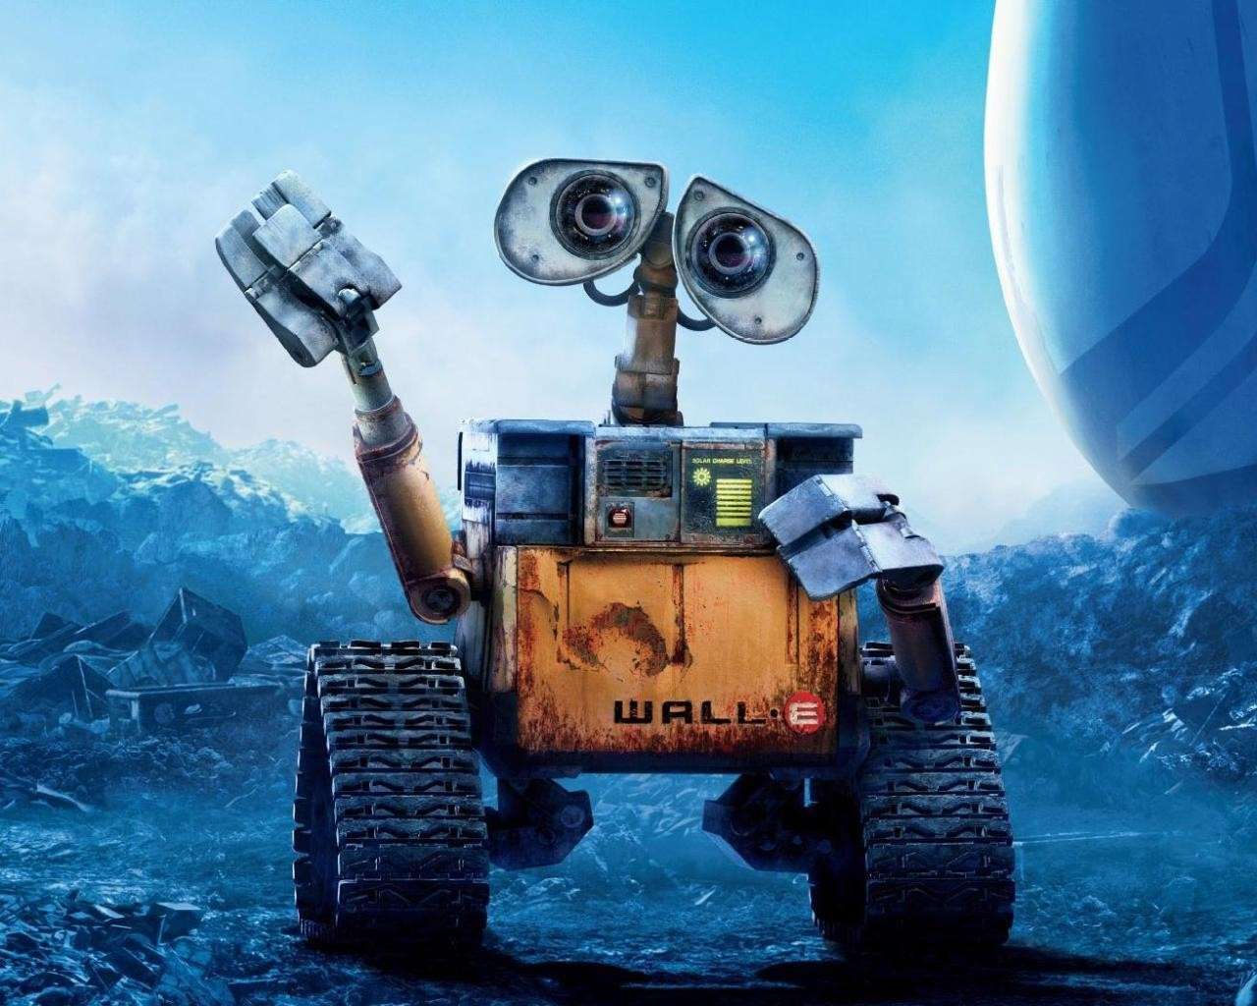
AI in Fiction
“Wall-E”, 2008, by Andrew Stanton
... and many others ...
5 / 39

Slide 13
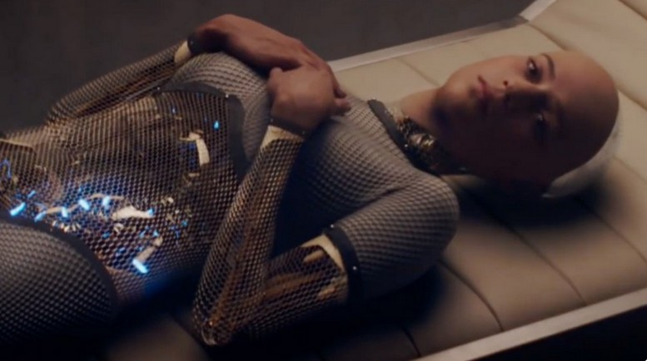
AI in Fiction
“Ex Machina”, 2015, by Alex Garland
... and many others ...
5 / 39

Slide 14

AI in Fiction
“Blade Runner, 2049”, 2017, by Denis Villeneuve
... and many others ...
5 / 39

Slide 15
AI in Fiction
... and many others ...
(see, e.g., https://www.looper.com/198685/ the-stunning-evolution-of-ai-in-movies/)
5 / 39

Slide 16
Many AI fantasies from fiction are becoming reality ...
AI in Reality

Slide 17
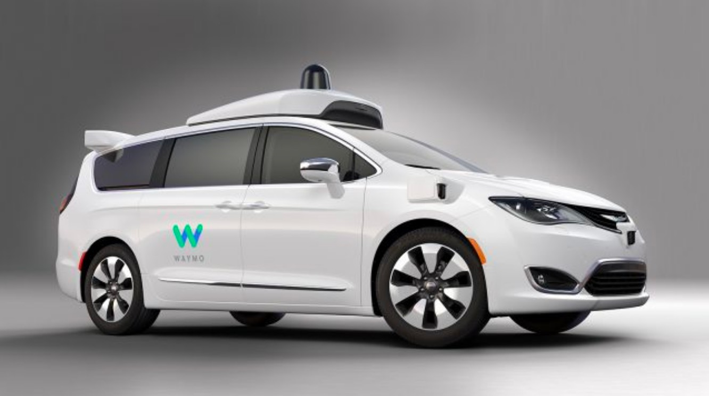
AI in Reality
... self-driving cars, ...
Oc WATMO Inc.

Slide 18
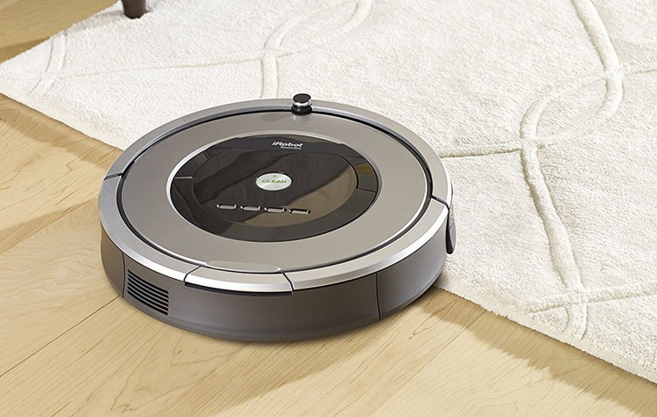
AI in Reality
... autonomous vacuum cleaners, ...
Oc iRobot Inc.
7 / 39

Slide 19
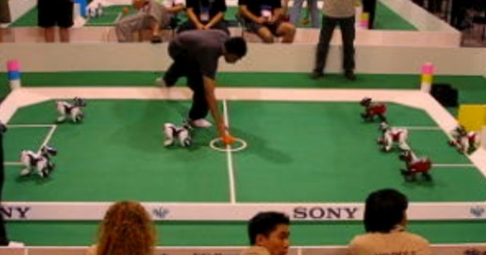
AI in Reality
... soccer-playing robots, ...
Oc Sony
7 / 39

Slide 20
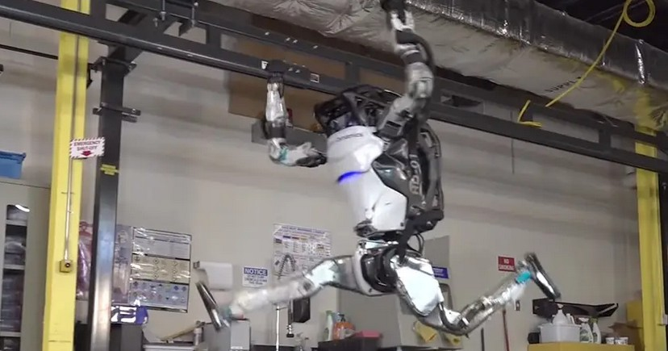
AI in Reality
.. acrobatic humanoid robots, ...
Oc Boston Dynamics
7 / 39

Slide 21

AI in Reality
... autonomous trading bots, ...
7 / 39

Slide 22
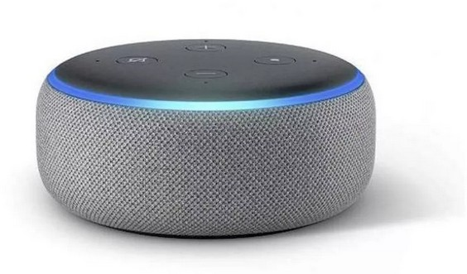
AI in Reality
..., vocal assistants, ...
Oc Amazon
7 / 39

Slide 23
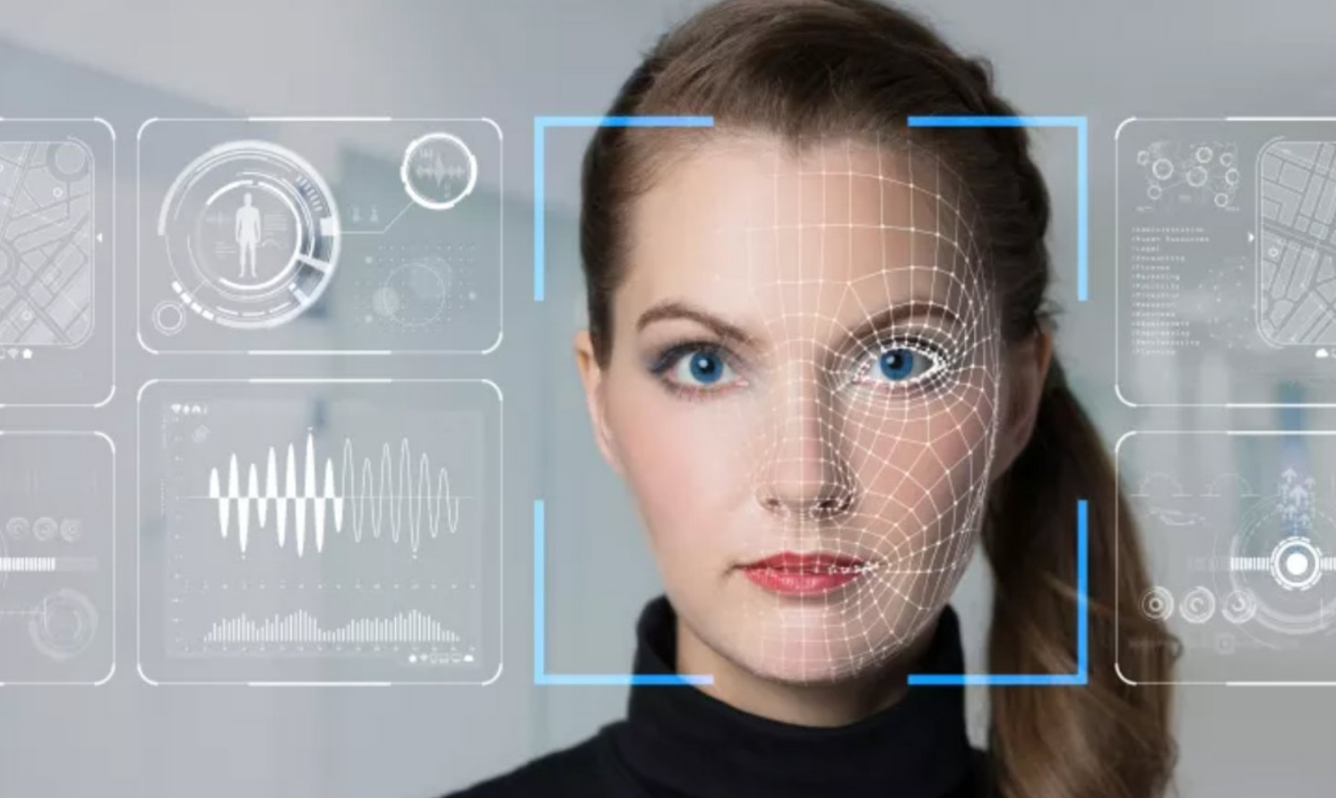
AI in Reality
... image/face recognition tools, ...
7 / 39

Slide 24
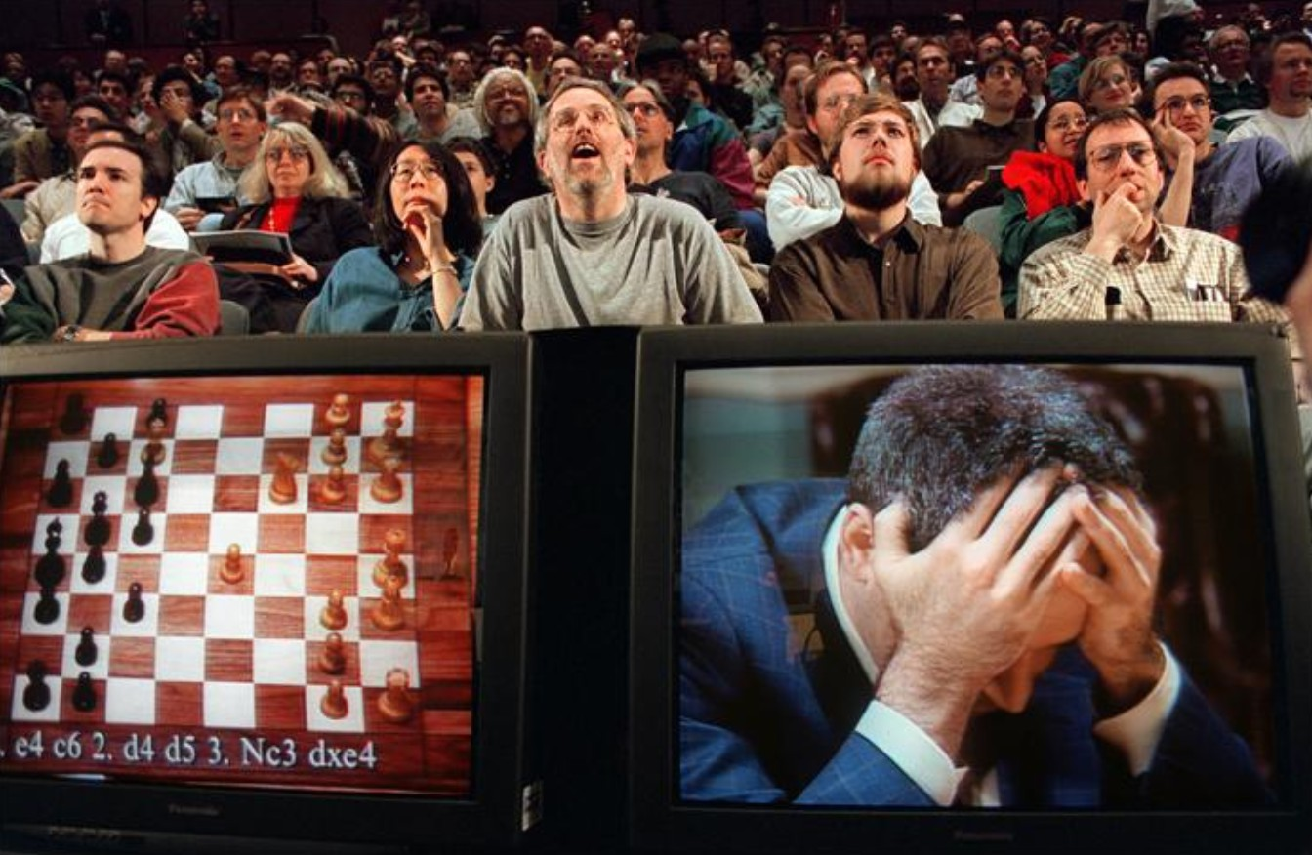
AI in Reality
... world-champion beating chess players, ...
7 / 39

Slide 25
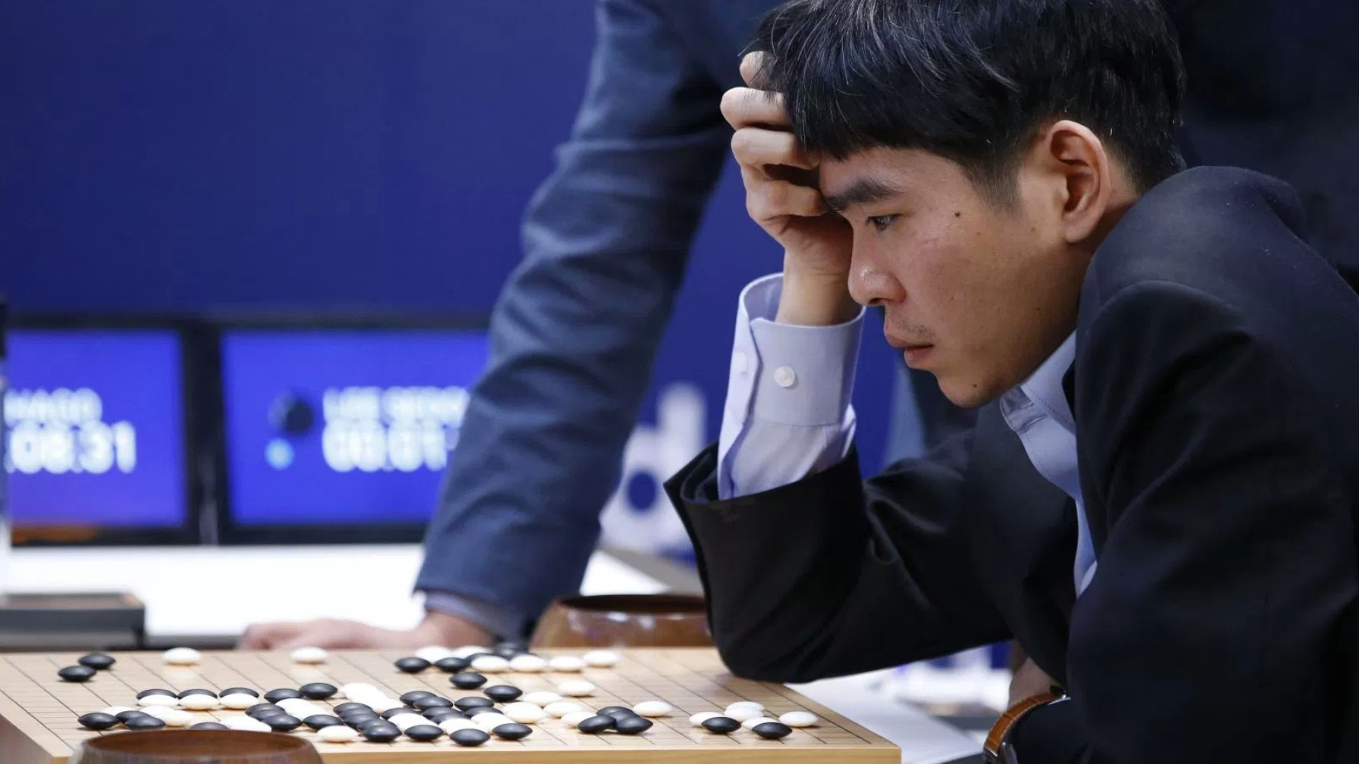
AI in Reality
... world-champion beating go players, ...
7 / 39

Slide 26
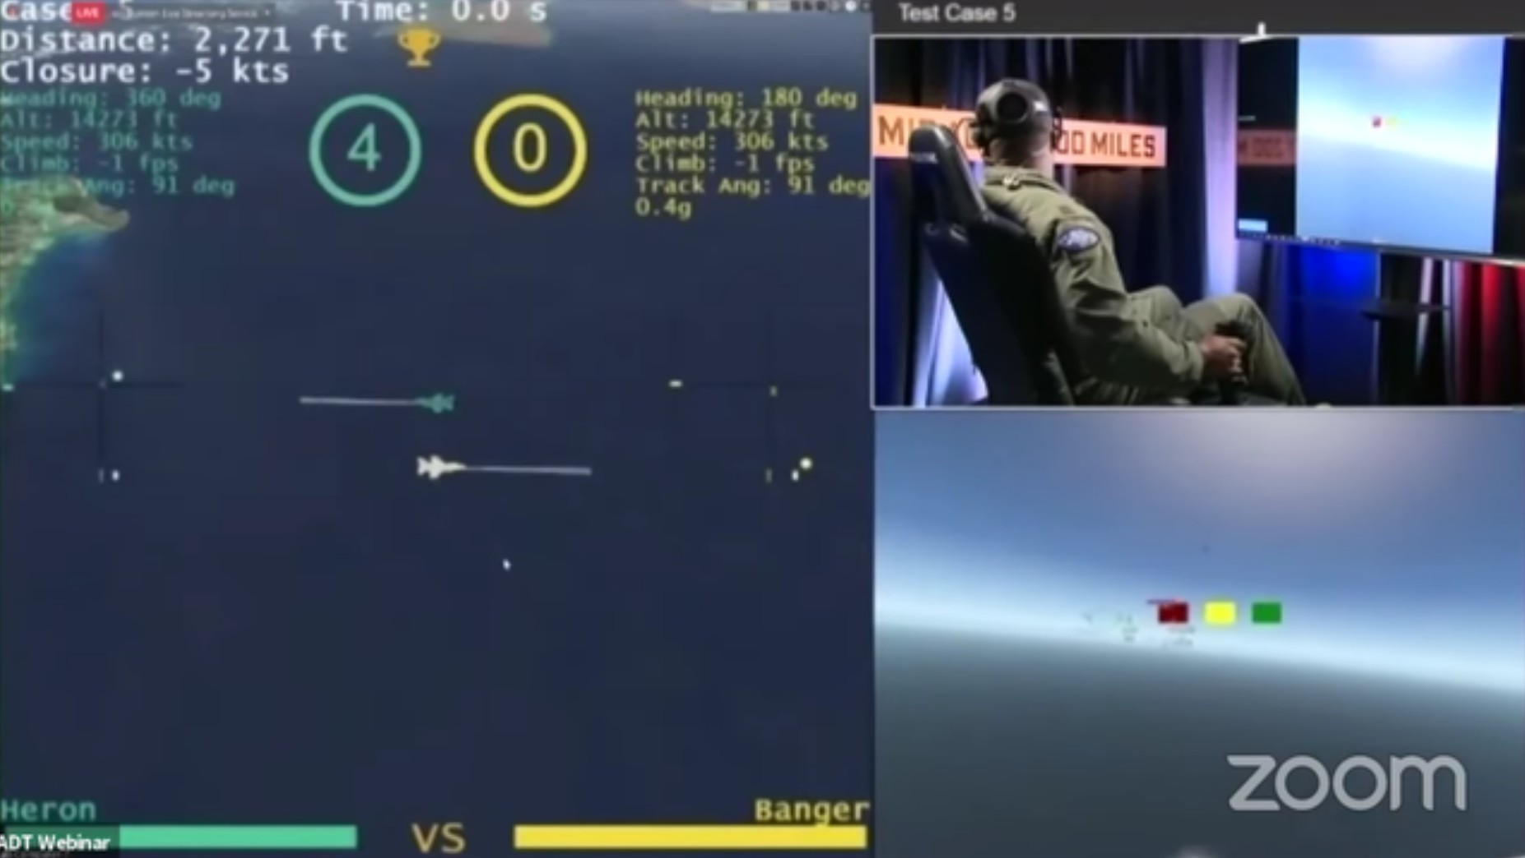
AI in Reality
... AI fighter pilots, ...
7 / 39

Slide 27
AI in Reality
... and many others ...
7 / 39

Slide 28

Outline
1
AI: Fiction vs. Reality
2
What is AI?
3
Foundations and History of AI
4
AI: State of the Art

Slide 29
Intelligence vs. Artificial Intelligence
Intelligence
For thousands of years, we have tried to understand how we think:
how can a “handful of matter” perceive, understand, predict, and manipulate a world far larger and more complicated than itself?
involves many disciplines, including logic, psychology, cognitive science, neuroscience, philosophy, ethics, linguistics, ...
Artificial Intelligence
The field of Artificial Intelligence (AI) goes further still:
it attempts not just to understand, but also to build intelligent entities
involves all the above disciplines, but also mathematics, computer science, engineering, economics, control theory & cybernetics, electronics, ...

Slide 30
Intelligence vs. Artificial Intelligence
Intelligence
For thousands of years, we have tried to understand how we think:
how can a “handful of matter” perceive, understand, predict, and manipulate a world far larger and more complicated than itself?
involves many disciplines, including logic, psychology, cognitive science, neuroscience, philosophy, ethics, linguistics, ...
Artificial Intelligence
The field of Artificial Intelligence (AI) goes further still:
it attempts not just to understand, but also to build intelligent entities
involves all the above disciplines, but also mathematics, computer science, engineering, economics, control theory & cybernetics, electronics, ...
9 / 39

Slide 31
Intelligence vs. Artificial Intelligence
Intelligence
For thousands of years, we have tried to understand how we think:
how can a “handful of matter” perceive, understand, predict, and manipulate a world far larger and more complicated than itself?
involves many disciplines, including logic, psychology, cognitive science, neuroscience, philosophy, ethics, linguistics, ...
Artificial Intelligence
The field of Artificial Intelligence (AI) goes further still:
it attempts not just to understand, but also to build intelligent entities
involves all the above disciplines, but also mathematics, computer science, engineering, economics, control theory & cybernetics, electronics, ...
9 / 39

Slide 32
Intelligence vs. Artificial Intelligence
Intelligence
For thousands of years, we have tried to understand how we think:
how can a “handful of matter” perceive, understand, predict, and manipulate a world far larger and more complicated than itself?
involves many disciplines, including logic, psychology, cognitive science, neuroscience, philosophy, ethics, linguistics, ...
Artificial Intelligence
The field of Artificial Intelligence (AI) goes further still:
it attempts not just to understand, but also to build intelligent entities
involves all the above disciplines, but also mathematics, computer science, engineering, economics, control theory & cybernetics, electronics, ...
9 / 39

Slide 33
Intelligence vs. Artificial Intelligence
Intelligence
For thousands of years, we have tried to understand how we think:
how can a “handful of matter” perceive, understand, predict, and manipulate a world far larger and more complicated than itself?
involves many disciplines, including logic, psychology, cognitive science, neuroscience, philosophy, ethics, linguistics, ...
Artificial Intelligence
The field of Artificial Intelligence (AI) goes further still:
it attempts not just to understand, but also to build intelligent entities
involves all the above disciplines, but also mathematics, computer science, engineering, economics, control theory & cybernetics, electronics, ...
9 / 39

Slide 34
Intelligence vs. Artificial Intelligence
Intelligence
For thousands of years, we have tried to understand how we think:
how can a “handful of matter” perceive, understand, predict, and manipulate a world far larger and more complicated than itself?
involves many disciplines, including logic, psychology, cognitive science, neuroscience, philosophy, ethics, linguistics, ...
Artificial Intelligence
The field of Artificial Intelligence (AI) goes further still:
it attempts not just to understand, but also to build intelligent entities
involves all the above disciplines, but also mathematics, computer science, engineering, economics, control theory & cybernetics, electronics, ...

Slide 35
What is Intelligence?
Intelligence (from Wikipedia)
“Intelligence has been defined in many ways: the capacity for logic, understanding, self-awareness, learning, emotional knowledge, reasoning, planning, creativity, critical thinking, and problem-solving. More generally, it can be described as the ability to perceive or infer information, and to retain it as knowledge to be applied towards adaptive behaviors within an environment or context. (...)”
10 / 39

Slide 36
What is Intelligence?
Intelligence (from Wikipedia)
“Intelligence has been defined in many ways: the capacity for logic, understanding, self-awareness, learning, emotional knowledge, reasoning, planning, creativity, critical thinking, and problem-solving. More generally, it can be described as the ability to perceive or infer information, and to retain it as knowledge to be applied towards adaptive behaviors within an environment or context. (...)”
10 / 39

Slide 37
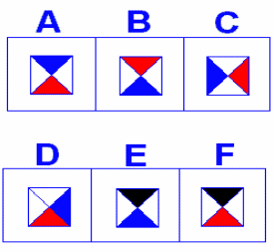
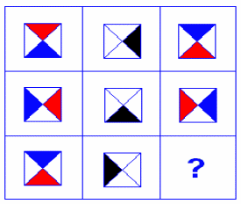
What is Intelligence? [cont.]
Example: simple puzzle
(Courtesy of Michela Milano, UniBO)
What is the solution of this puzzle?
=⇒ (I’d say) B: result of column-by-column clockwise rotation
What have you done for solving it?
1
2
read & recognize figures =⇒ perceive information recognize patterns, problem and candidate solutions
=⇒ retain knowledge
choose solution =⇒ infer other knowledge
3
11 / 39

Slide 38
What is Intelligence? [cont.]
Example: simple puzzle
(Courtesy of Michela Milano, UniBO)
What is the solution of this puzzle?
=⇒ (I’d say) B: result of column-by-column clockwise rotation
What have you done for solving it?
1
2
read & recognize figures =⇒ perceive information recognize patterns, problem and candidate solutions
=⇒ retain knowledge
choose solution =⇒ infer other knowledge
3
11 / 39

Slide 39
What is Intelligence? [cont.]
Example: simple puzzle
(Courtesy of Michela Milano, UniBO)
What is the solution of this puzzle?
=⇒ (I’d say) B: result of column-by-column clockwise rotation
What have you done for solving it?
1
2
read & recognize figures =⇒ perceive information recognize patterns, problem and candidate solutions
=⇒ retain knowledge
choose solution =⇒ infer other knowledge
3
11 / 39

Slide 40
What is Intelligence? [cont.]
Example: simple puzzle
(Courtesy of Michela Milano, UniBO)
What is the solution of this puzzle?
=⇒ (I’d say) B: result of column-by-column clockwise rotation
What have you done for solving it?
1
2
read & recognize figures =⇒ perceive information recognize patterns, problem and candidate solutions
=⇒ retain knowledge
choose solution =⇒ infer other knowledge
3
11 / 39

Slide 41
What is Intelligence? [cont.]
Example: simple puzzle
(Courtesy of Michela Milano, UniBO)
What is the solution of this puzzle?
=⇒ (I’d say) B: result of column-by-column clockwise rotation
What have you done for solving it?
1
2
read & recognize figures =⇒ perceive information recognize patterns, problem and candidate solutions
=⇒ retain knowledge
choose solution =⇒ infer other knowledge
3
11 / 39

Slide 42
What is Intelligence? [cont.]
Example: simple puzzle
(Courtesy of Michela Milano, UniBO)
What is the solution of this puzzle?
=⇒ (I’d say) B: result of column-by-column clockwise rotation
What have you done for solving it?
1
2
read & recognize figures =⇒ perceive information recognize patterns, problem and candidate solutions
=⇒ retain knowledge
choose solution =⇒ infer other knowledge
3

Slide 43
What is Artificial Intelligence?
Different definitions due to different criteria
Historically, four approaches, along two orthogonal dimensions: thought processes & reasoning
vs.
behavior & action
Success according to human standards vs.
success according to an ideal concept of intelligence: rationality.
human-centered approach: involves observations and hypotheses about human behavior
rationalist approach involves a combination of mathematics and engineering.
The four groups have both disparaged and helped each other.

Slide 44
What is Artificial Intelligence?
Different definitions due to different criteria
Historically, four approaches, along two orthogonal dimensions: thought processes & reasoning
vs.
behavior & action
Success according to human standards vs.
success according to an ideal concept of intelligence: rationality.
human-centered approach: involves observations and hypotheses about human behavior
rationalist approach involves a combination of mathematics and engineering.
The four groups have both disparaged and helped each other.
12 / 39

Slide 45
What is Artificial Intelligence?
Different definitions due to different criteria
Historically, four approaches, along two orthogonal dimensions: thought processes & reasoning
vs.
behavior & action
Success according to human standards vs.
success according to an ideal concept of intelligence: rationality.
human-centered approach: involves observations and hypotheses about human behavior
rationalist approach involves a combination of mathematics and engineering.
The four groups have both disparaged and helped each other.
12 / 39

Slide 46
What is Artificial Intelligence?
Different definitions due to different criteria
Historically, four approaches, along two orthogonal dimensions: thought processes & reasoning
vs.
behavior & action
Success according to human standards vs.
success according to an ideal concept of intelligence: rationality.
human-centered approach: involves observations and hypotheses about human behavior
rationalist approach involves a combination of mathematics and engineering.
The four groups have both disparaged and helped each other.

Slide 47
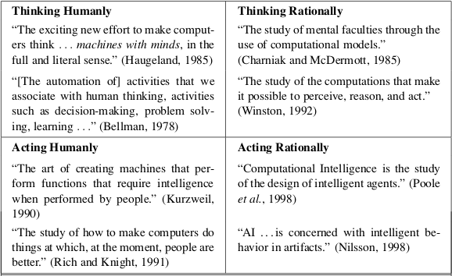
What is Artificial Intelligence? [cont.]
(Oc S. Russell & P. Norwig, AIMA)

Slide 48
Thinking Humanly: The cognitive modeling approach
Problem: How do humans think?
Idea: develop a theory of the mind
=⇒ express the theory as computer programs
e.g. Newell & Simon’s General Problem Solver (1961)
Requires scientific theories of brain activities (cognitive model)
Inter-disciplinary field: Cognitive Science
combines computer models from AI and experimental techniques from psychology
construct precise and testable theories of the human mind
AI and Cognitive Science nowadays distinct A.I: find an algorithm performing well on a task C.S: find a good model of human performance
although they fertilize each other (e.g. in computer vision)

Slide 49
Thinking Humanly: The cognitive modeling approach
Problem: How do humans think?
Idea: develop a theory of the mind
=⇒ express the theory as computer programs
e.g. Newell & Simon’s General Problem Solver (1961)
Requires scientific theories of brain activities (cognitive model)
Inter-disciplinary field: Cognitive Science
combines computer models from AI and experimental techniques from psychology
construct precise and testable theories of the human mind
AI and Cognitive Science nowadays distinct A.I: find an algorithm performing well on a task C.S: find a good model of human performance
although they fertilize each other (e.g. in computer vision)
14 / 39

Slide 50
Thinking Humanly: The cognitive modeling approach
Problem: How do humans think?
Idea: develop a theory of the mind
=⇒ express the theory as computer programs
e.g. Newell & Simon’s General Problem Solver (1961)
Requires scientific theories of brain activities (cognitive model)
Inter-disciplinary field: Cognitive Science
combines computer models from AI and experimental techniques from psychology
construct precise and testable theories of the human mind
AI and Cognitive Science nowadays distinct A.I: find an algorithm performing well on a task C.S: find a good model of human performance
although they fertilize each other (e.g. in computer vision)
14 / 39

Slide 51
Thinking Humanly: The cognitive modeling approach
Problem: How do humans think?
Idea: develop a theory of the mind
=⇒ express the theory as computer programs
e.g. Newell & Simon’s General Problem Solver (1961)
Requires scientific theories of brain activities (cognitive model)
Inter-disciplinary field: Cognitive Science
combines computer models from AI and experimental techniques from psychology
construct precise and testable theories of the human mind
AI and Cognitive Science nowadays distinct A.I: find an algorithm performing well on a task C.S: find a good model of human performance
although they fertilize each other (e.g. in computer vision)

Slide 52
Acting Humanly: The Turing Test Approach
Problem: When does a system behave intelligently?
The Turing Test
Alan Turing “Computing Machinery and Intelligence” (1950)
Operational test of intelligence (aka “The Imitation game”):
”behave intelligently” ⇐⇒ ”behave humanly”
15 / 39

Slide 53
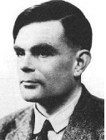
Acting Humanly: The Turing Test Approach
Problem: When does a system behave intelligently?
The Turing Test
Alan Turing “Computing Machinery and Intelligence” (1950)
Operational test of intelligence (aka “The Imitation game”):
A human, a computer, an interrogator in a different room.
The interrogator should classify the human and the machine.
Can the computer mislead the interrogator and
be classified as a human?
”behave intelligently” ⇐⇒ ”behave humanly”
15 / 39

Slide 54

Acting Humanly: The Turing Test Approach
Problem: When does a system behave intelligently?
The Turing Test
Alan Turing “Computing Machinery and Intelligence” (1950)
Operational test of intelligence (aka “The Imitation game”):
A human, a computer, an interrogator in a different room.
The interrogator should classify the human and the machine.
Can the computer mislead the interrogator and
be classified as a human?
”behave intelligently” ⇐⇒ ”behave humanly”
15 / 39

Slide 55
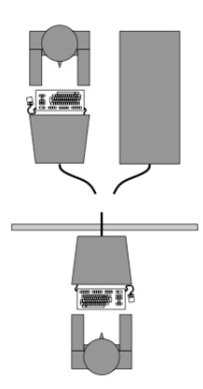
Acting Humanly: The Turing Test Approach
Problem: When does a system behave intelligently?
The Turing Test
Alan Turing “Computing Machinery and Intelligence” (1950)
Operational test of intelligence (aka “The Imitation game”):
A human, a computer, an interrogator in a different room.
The interrogator should classify the human and the machine.
Can the computer mislead the interrogator and
be classified as a human?
”behave intelligently” ⇐⇒ ”behave humanly”
15 / 39

Slide 56
Acting Humanly: The Turing Test Approach
Problem: When does a system behave intelligently?
The Turing Test
Alan Turing “Computing Machinery and Intelligence” (1950)
Operational test of intelligence (aka “The Imitation game”):
A human, a computer, an interrogator in a different room.
The interrogator should classify the human and the machine.
Can the computer mislead the interrogator and
be classified as a human?
”behave intelligently” ⇐⇒ ”behave humanly”

Slide 57
Acting Humanly: The Turing Test Approach [cont.]
Capabilities for passing the Turing Test
natural language processing to enable it to communicate successfully in English (or other)
knowledge representation to store what it knows or hears
automated reasoning to answer questions and to draw new conclusions
machine learning to adapt to new circumstances and to detect and extrapolate patterns
For Total Turing test (with physical interaction wrt. interrogator): computer vision to perceive objects
computer speech to communicate orally robotics to manipulate objects and move about
These disciplines compose most of AI
Turing Test is still relevant in AI (although not fundamental)

Slide 58
Acting Humanly: The Turing Test Approach [cont.]
Capabilities for passing the Turing Test
natural language processing to enable it to communicate successfully in English (or other)
knowledge representation to store what it knows or hears
automated reasoning to answer questions and to draw new conclusions
machine learning to adapt to new circumstances and to detect and extrapolate patterns
For Total Turing test (with physical interaction wrt. interrogator): computer vision to perceive objects
computer speech to communicate orally robotics to manipulate objects and move about
These disciplines compose most of AI
Turing Test is still relevant in AI (although not fundamental)
16 / 39

Slide 59
Acting Humanly: The Turing Test Approach [cont.]
Capabilities for passing the Turing Test
natural language processing to enable it to communicate successfully in English (or other)
knowledge representation to store what it knows or hears
automated reasoning to answer questions and to draw new conclusions
machine learning to adapt to new circumstances and to detect and extrapolate patterns
For Total Turing test (with physical interaction wrt. interrogator): computer vision to perceive objects
computer speech to communicate orally robotics to manipulate objects and move about
These disciplines compose most of AI
Turing Test is still relevant in AI (although not fundamental)
16 / 39

Slide 60
Acting Humanly: The Turing Test Approach [cont.]
Capabilities for passing the Turing Test
natural language processing to enable it to communicate successfully in English (or other)
knowledge representation to store what it knows or hears
automated reasoning to answer questions and to draw new conclusions
machine learning to adapt to new circumstances and to detect and extrapolate patterns
For Total Turing test (with physical interaction wrt. interrogator): computer vision to perceive objects
computer speech to communicate orally robotics to manipulate objects and move about
These disciplines compose most of AI
Turing Test is still relevant in AI (although not fundamenta)
16 / 39

Slide 61
Acting Humanly: The Turing Test Approach [cont.]
Capabilities for passing the Turing Test
natural language processing to enable it to communicate successfully in English (or other)
knowledge representation to store what it knows or hears
automated reasoning to answer questions and to draw new conclusions
machine learning to adapt to new circumstances and to detect and extrapolate patterns
For Total Turing test (with physical interaction wrt. interrogator): computer vision to perceive objects
computer speech to communicate orally robotics to manipulate objects and move about
These disciplines compose most of AI
Turing Test is still relevant in AI (although not fundamental)
16 / 39

Slide 62
Acting Humanly: The Turing Test Approach [cont.]
Capabilities for passing the Turing Test
natural language processing to enable it to communicate successfully in English (or other)
knowledge representation to store what it knows or hears
automated reasoning to answer questions and to draw new conclusions
machine learning to adapt to new circumstances and to detect and extrapolate patterns
For Total Turing test (with physical interaction wrt. interrogator): computer vision to perceive objects
computer speech to communicate orally robotics to manipulate objects and move about
These disciplines compose most of AI
Turing Test is still relevant in AI (although not fundamental)
16 / 39

Slide 63
Acting Humanly: The Turing Test Approach [cont.]
Capabilities for passing the Turing Test
natural language processing to enable it to communicate successfully in English (or other)
knowledge representation to store what it knows or hears
automated reasoning to answer questions and to draw new conclusions
machine learning to adapt to new circumstances and to detect and extrapolate patterns
For Total Turing test (with physical interaction wrt. interrogator): computer vision to perceive objects
computer speech to communicate orally robotics to manipulate objects and move about
These disciplines compose most of AI
Turing Test is still relevant in AI (although not fundamental)
16 / 39

Slide 64
Acting Humanly: The Turing Test Approach [cont.]
Capabilities for passing the Turing Test
natural language processing to enable it to communicate successfully in English (or other)
knowledge representation to store what it knows or hears
automated reasoning to answer questions and to draw new conclusions
machine learning to adapt to new circumstances and to detect and extrapolate patterns
For Total Turing test (with physical interaction wrt. interrogator): computer vision to perceive objects
computer speech to communicate orally robotics to manipulate objects and move about
These disciplines compose most of AI
Turing Test is still relevant in AI (although not fundamental)
16 / 39

Slide 65
Acting Humanly: The Turing Test Approach [cont.]
Capabilities for passing the Turing Test
natural language processing to enable it to communicate successfully in English (or other)
knowledge representation to store what it knows or hears
automated reasoning to answer questions and to draw new conclusions
machine learning to adapt to new circumstances and to detect and extrapolate patterns
For Total Turing test (with physical interaction wrt. interrogator): computer vision to perceive objects
computer speech to communicate orally robotics to manipulate objects and move about
These disciplines compose most of AI
Turing Test is still relevant in AI (although not fundamental)
16 / 39

Slide 66
Acting Humanly: The Turing Test Approach [cont.]
Some successes with Turing test
(2014) a chatbot by Eugene Goostman, mimicking the answer of a 13 years old boy, has succeeded the test.
chatbots are now frequently available
vocal assistants are now of common use
e.g. Alexa (Amazon), Siri (Apple), Cortana (Microsoft), ...
Limitations of Turing Test
not reproducible, constructive or amenable to mathematical analysis
AI researchers devoted little effort to make systems pass the Turing Test
[ Do humans always pass the Turing test? (See e.g. here) ] Should we really emulate humans to achieve intelligence?
Shouldn’t we study the underlying principles of intelligence instead?
17 / 39

Slide 67
Acting Humanly: The Turing Test Approach [cont.]
Some successes with Turing test
(2014) a chatbot by Eugene Goostman, mimicking the answer of a 13 years old boy, has succeeded the test.
chatbots are now frequently available
vocal assistants are now of common use
e.g. Alexa (Amazon), Siri (Apple), Cortana (Microsoft), ...
Limitations of Turing Test
not reproducible, constructive or amenable to mathematical analysis
AI researchers devoted little effort to make systems pass the Turing Test
[ Do humans always pass the Turing test? (See e.g. here) ] Should we really emulate humans to achieve intelligence?
Shouldn’t we study the underlying principles of intelligence instead?
17 / 39

Slide 68
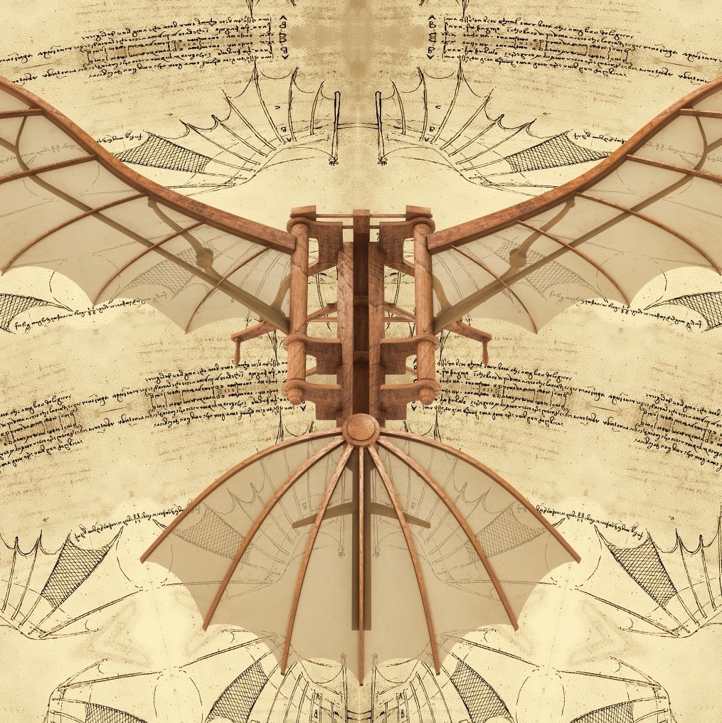
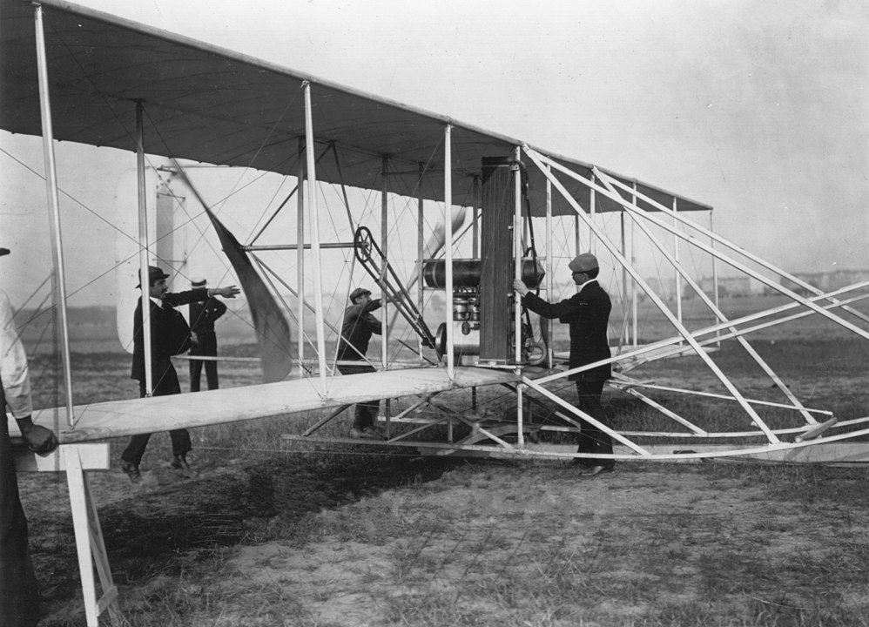
Acting Humanly: The Turing Test Approach [cont.]
Metaphorical Example
Successful flight machines have not been developed by imitating birds, rather by studying engines and aerodynamics.
(see e.g. this video.

Slide 69
Thinking Rationally: The “Laws of Thought” Approach
Problem: Can we capture the laws of thought?
Aristotle: What are correct argument and thought processes? codify “right thinking” i.e. irrefutable reasoning processes (syllogisms): (e.g. “all men are mortal; Socrates is a man; therefore, Socrates is mortal”)
=⇒ Logic and Logical inference
The Logicist tradition in AI hopes to create intelligent systems using logic-based inference systems
“algorithm = logic + control”
logic programming, automated-deduction systems, ...
logics: propositional, first-order, modal & decription, temporal, ...
Two main limitations:
not easy to state informal knowledge into the formal terms of logic problems undecidable or computationally very hard (NP-hard)
Logical reasoning is currently part of many fields of AI
problem solving, knowledge representation & reasoning, planning, does not exhaustively cover AI

Slide 70
Thinking Rationally: The “Laws of Thought” Approach
Problem: Can we capture the laws of thought?
Aristotle: What are correct argument and thought processes? codify “right thinking” i.e. irrefutable reasoning processes (syllogisms): (e.g. “all men are mortal; Socrates is a man; therefore, Socrates is mortal”)
=⇒ Logic and Logical inference
The Logicist tradition in AI hopes to create intelligent systems using logic-based inference systems
“algorithm = logic + control”
logic programming, automated-deduction systems, ...
logics: propositional, first-order, modal & decription, temporal, ...
Two main limitations:
not easy to state informal knowledge into the formal terms of logic problems undecidable or computationally very hard (NP-hard)
Logical reasoning is currently part of many fields of AI
problem solving, knowledge representation & reasoning, planning, does not exhaustively cover AI
19 / 39

Slide 71
Thinking Rationally: The “Laws of Thought” Approach
Problem: Can we capture the laws of thought?
Aristotle: What are correct argument and thought processes? codify “right thinking” i.e. irrefutable reasoning processes (syllogisms): (e.g. “all men are mortal; Socrates is a man; therefore, Socrates is mortal”)
=⇒ Logic and Logical inference
The Logicist tradition in AI hopes to create intelligent systems using logic-based inference systems
“algorithm = logic + control”
logic programming, automated-deduction systems, ...
logics: propositional, first-order, modal & decription, temporal, ...
Two main limitations:
not easy to state informal knowledge into the formal terms of logic problems undecidable or computationally very hard (NP-hard)
Logical reasoning is currently part of many fields of AI
problem solving, knowledge representation & reasoning, planning, does not exhaustively cover AI
19 / 39

Slide 72
Thinking Rationally: The “Laws of Thought” Approach
Problem: Can we capture the laws of thought?
Aristotle: What are correct argument and thought processes? codify “right thinking” i.e. irrefutable reasoning processes (syllogisms): (e.g. “all men are mortal; Socrates is a man; therefore, Socrates is mortal”)
=⇒ Logic and Logical inference
The Logicist tradition in AI hopes to create intelligent systems using logic-based inference systems
“algorithm = logic + control”
logic programming, automated-deduction systems, ...
logics: propositional, first-order, modal & decription, temporal, ...
Two main limitations:
not easy to state informal knowledge into the formal terms of logic problems undecidable or computationally very hard (NP-hard)
Logical reasoning is currently part of many fields of AI
problem solving, knowledge representation & reasoning, planning, does not exhaustively cover AI
19 / 39

Slide 73
Thinking Rationally: The “Laws of Thought” Approach
Problem: Can we capture the laws of thought?
Aristotle: What are correct argument and thought processes? codify “right thinking” i.e. irrefutable reasoning processes (syllogisms): (e.g. “all men are mortal; Socrates is a man; therefore, Socrates is mortal”)
=⇒ Logic and Logical inference
The Logicist tradition in AI hopes to create intelligent systems using logic-based inference systems
“algorithm = logic + control”
logic programming, automated-deduction systems, ...
logics: propositional, first-order, modal & decription, temporal, ...
Two main limitations:
not easy to state informal knowledge into the formal terms of logic problems undecidable or computationally very hard (NP-hard)
Logical reasoning is currently part of many fields of AI
problem solving, knowledge representation & reasoning, planning, does not exhaustively cover AI

Slide 74
Acting Rationally: The Rational-Agent Approach
Problem: Can we make systems “do the right thing”? Rational Agents
An agent is an entity that perceives and acts
A rational agent acts so as
Rational agents need all skills needed for the Turing Test! Thinking rationally is sometimes part of being a rational agent
Two advantages over previous approaches:
20 / 39

Slide 75
Acting Rationally: The Rational-Agent Approach
Problem: Can we make systems “do the right thing”? Rational Agents
An agent is an entity that perceives and acts
persists over a prolonged time period
A rational agent acts so as
to achieve the best outcome (maximize goal achievement), or to achieve the best expected outcome (under uncertainty)
Rational agents need all skills needed for the Turing Test!
Thinking rationally is sometimes part of being a rational agent
e.g. planning an action
sometimes action without thinking (e.g. reflexes)
Two advantages over previous approaches:
More general than law of thoughts approach (correct inference is just one of several possible mechanisms for achieving rationality) More amenable to scientific development than human-emulation approaches (rationality mathematically well defined & general)
20 / 39

Slide 76
Acting Rationally: The Rational-Agent Approach
Problem: Can we make systems “do the right thing”? Rational Agents
An agent is an entity that perceives and acts
persists over a prolonged time period
A rational agent acts so as
to achieve the best outcome (maximize goal achievement), or to achieve the best expected outcome (under uncertainty)
Rational agents need all skills needed for the Turing Test!
Thinking rationally is sometimes part of being a rational agent
e.g. planning an action
sometimes action without thinking (e.g. reflexes)
Two advantages over previous approaches:
More general than law of thoughts approach (correct inference is just one of several possible mechanisms for achieving rationality) More amenable to scientific development than human-emulation approaches (rationality mathematically well defined & general)
20 / 39

Slide 77
Acting Rationally: The Rational-Agent Approach
Problem: Can we make systems “do the right thing”? Rational Agents
An agent is an entity that perceives and acts
persists over a prolonged time period
A rational agent acts so as
to achieve the best outcome (maximize goal achievement), or to achieve the best expected outcome (under uncertainty)
Rational agents need all skills needed for the Turing Test!
Thinking rationally is sometimes part of being a rational agent
e.g. planning an action
sometimes action without thinking (e.g. reflexes)
Two advantages over previous approaches:
More general than law of thoughts approach (correct inference is just one of several possible mechanisms for achieving rationality) More amenable to scientific development than human-emulation approaches (rationality mathematically well defined & general)
20 / 39

Slide 78
Acting Rationally: The Rational-Agent Approach
Problem: Can we make systems “do the right thing”? Rational Agents
An agent is an entity that perceives and acts
persists over a prolonged time period
A rational agent acts so as
to achieve the best outcome (maximize goal achievement), or to achieve the best expected outcome (under uncertainty)
Rational agents need all skills needed for the Turing Test!
Thinking rationally is sometimes part of being a rational agent
e.g. planning an action
sometimes action without thinking (e.g. reflexes)
Two advantages over previous approaches:
More general than law of thoughts approach (correct inference is just one of several possible mechanisms for achieving rationality) More amenable to scientific development than human-emulation approaches (rationality mathematically well defined & general)
20 / 39

Slide 79
Acting Rationally: The Rational-Agent Approach
Problem: Can we make systems “do the right thing”? Rational Agents
An agent is an entity that perceives and acts
persists over a prolonged time period
A rational agent acts so as
to achieve the best outcome (maximize goal achievement), or to achieve the best expected outcome (under uncertainty)
Rational agents need all skills needed for the Turing Test!
Thinking rationally is sometimes part of being a rational agent
e.g. planning an action
sometimes action without thinking (e.g. reflexes)
Two advantages over previous approaches:
More general than law of thoughts approach (correct inference is just one of several possible mechanisms for achieving rationality) More amenable to scientific development than human-emulation approaches (rationality mathematically well defined & general)
20 / 39

Slide 80
Acting Rationally: The Rational-Agent Approach
Problem: Can we make systems “do the right thing”? Rational Agents
An agent is an entity that perceives and acts
persists over a prolonged time period
A rational agent acts so as
to achieve the best outcome (maximize goal achievement), or to achieve the best expected outcome (under uncertainty)
Rational agents need all skills needed for the Turing Test!
Thinking rationally is sometimes part of being a rational agent
e.g. planning an action
sometimes action without thinking (e.g. reflexes)
Two advantages over previous approaches:
More general than law of thoughts approach (correct inference is just one of several possible mechanisms for achieving rationality) More amenable to scientific development than human-emulation approaches (rationality mathematically well defined & general)
20 / 39

Slide 81
Acting Rationally: The Rational-Agent Approach
Problem: Can we make systems “do the right thing”? Rational Agents
An agent is an entity that perceives and acts
persists over a prolonged time period
A rational agent acts so as
to achieve the best outcome (maximize goal achievement), or to achieve the best expected outcome (under uncertainty)
Rational agents need all skills needed for the Turing Test!
Thinking rationally is sometimes part of being a rational agent
e.g. planning an action
sometimes action without thinking (e.g. reflexes)
Two advantages over previous approaches:
More general than law of thoughts approach (correct inference is just one of several possible mechanisms for achieving rationality) More amenable to scientific development than human-emulation approaches (rationality mathematically well defined & general)
20 / 39

Slide 82
Acting Rationally: The Rational-Agent Approach
Problem: Can we make systems “do the right thing”? Rational Agents
An agent is an entity that perceives and acts
persists over a prolonged time period
A rational agent acts so as
to achieve the best outcome (maximize goal achievement), or to achieve the best expected outcome (under uncertainty)
Rational agents need all skills needed for the Turing Test!
Thinking rationally is sometimes part of being a rational agent
e.g. planning an action
sometimes action without thinking (e.g. reflexes)
Two advantages over previous approaches:
More general than law of thoughts approach (correct inference is just one of several possible mechanisms for achieving rationality) More amenable to scientific development than human-emulation approaches (rationality mathematically well defined & general)
20 / 39

Slide 83
Acting Rationally: The Rational-Agent Approach
Problem: Can we make systems “do the right thing”? Rational Agents
An agent is an entity that perceives and acts
persists over a prolonged time period
A rational agent acts so as
to achieve the best outcome (maximize goal achievement), or to achieve the best expected outcome (under uncertainty)
Rational agents need all skills needed for the Turing Test!
Thinking rationally is sometimes part of being a rational agent
e.g. planning an action
sometimes action without thinking (e.g. reflexes)
Two advantages over previous approaches:
More general than law of thoughts approach (correct inference is just one of several possible mechanisms for achieving rationality) More amenable to scientific development than human-emulation approaches (rationality mathematically well defined & general)
20 / 39

Slide 84
Acting Rationally: The Rational-Agent Approach
Problem: Can we make systems “do the right thing”? Rational Agents
An agent is an entity that perceives and acts
persists over a prolonged time period
A rational agent acts so as
to achieve the best outcome (maximize goal achievement), or to achieve the best expected outcome (under uncertainty)
Rational agents need all skills needed for the Turing Test!
Thinking rationally is sometimes part of being a rational agent
e.g. planning an action
sometimes action without thinking (e.g. reflexes)
Two advantages over previous approaches:
More general than law of thoughts approach (correct inference is just one of several possible mechanisms for achieving rationality) More amenable to scientific development than human-emulation approaches (rationality mathematically well defined & general)
20 / 39

Slide 85
Acting Rationally: The Rational-Agent Approach
Problem: Can we make systems “do the right thing”? Rational Agents
An agent is an entity that perceives and acts
persists over a prolonged time period
A rational agent acts so as
to achieve the best outcome (maximize goal achievement), or to achieve the best expected outcome (under uncertainty)
Rational agents need all skills needed for the Turing Test!
Thinking rationally is sometimes part of being a rational agent
e.g. planning an action
sometimes action without thinking (e.g. reflexes)
Two advantages over previous approaches:
More general than law of thoughts approach (correct inference is just one of several possible mechanisms for achieving rationality) More amenable to scientific development than human-emulation approaches (rationality mathematically well defined & general)
20 / 39

Slide 86
Acting Rationally: The Rational-Agent Approach
Problem: Can we make systems “do the right thing”? Rational Agents
An agent is an entity that perceives and acts
persists over a prolonged time period
A rational agent acts so as
to achieve the best outcome (maximize goal achievement), or to achieve the best expected outcome (under uncertainty)
Rational agents need all skills needed for the Turing Test!
Thinking rationally is sometimes part of being a rational agent
e.g. planning an action
sometimes action without thinking (e.g. reflexes)
Two advantages over previous approaches:
More general than law of thoughts approach (correct inference is just one of several possible mechanisms for achieving rationality) More amenable to scientific development than human-emulation approaches (rationality mathematically well defined & general)
20 / 39

Slide 87
Acting Rationally: The Rational-Agent Approach
Problem: Can we make systems “do the right thing”? Rational Agents
An agent is an entity that perceives and acts
persists over a prolonged time period
A rational agent acts so as
to achieve the best outcome (maximize goal achievement), or to achieve the best expected outcome (under uncertainty)
Rational agents need all skills needed for the Turing Test!
Thinking rationally is sometimes part of being a rational agent
e.g. planning an action
sometimes action without thinking (e.g. reflexes)
Two advantages over previous approaches:
More general than law of thoughts approach (correct inference is just one of several possible mechanisms for achieving rationality) More amenable to scientific development than human-emulation approaches (rationality mathematically well defined & general)

Slide 88
Acting Rationally: The Rational-Agent Approach [c.]
This course concentrates on general principles of rational agents and on the components for constructing them. (Following AIMA book.)
Remark
achieving perfect rationality is not feasible in complex environments
computational demands too high
however, good working hypothesis and starting point for analysis
=⇒ dealing with limited rationality
acting appropriately when not enough time to do all computations
21 / 39

Slide 89
Acting Rationally: The Rational-Agent Approach [c.]
This course concentrates on general principles of rational agents and on the components for constructing them. (Following AIMA book.)
Remark
achieving perfect rationality is not feasible in complex environments
computational demands too high
however, good working hypothesis and starting point for analysis
=⇒ dealing with limited rationality
acting appropriately when not enough time to do all computations
21 / 39

Slide 90
AI Systems Classification
Weak vs. Strong AI
Weak AI: Is it possible to build systems that act as if they were intelligent?
Strong AI: Is it possible to build systems that are intelligent? (i.e., that have conscious minds, wills and sentiments?)
General AI vs. Narrow AI
General AI refers to systems able to cope with any generalized task which is asked of it, much like a human.
Narrow AI refers to systems able to handle one particular task.
=⇒ AI system displays a certain degree of intelligence only in a particular narrow field to perform highly specialized tasks
22 / 39

Slide 91
AI Systems Classification
Weak vs. Strong AI
Weak AI: Is it possible to build systems that act as if they were intelligent?
Strong AI: Is it possible to build systems that are intelligent? (i.e., that have conscious minds, wills and sentiments?)
General AI vs. Narrow AI
General AI refers to systems able to cope with any generalized task which is asked of it, much like a human.
Narrow AI refers to systems able to handle one particular task.
=⇒ AI system displays a certain degree of intelligence only in a particular narrow field to perform highly specialized tasks
22 / 39

Slide 92
AI Systems Classification
Weak vs. Strong AI
Weak AI: Is it possible to build systems that act as if they were intelligent?
Strong AI: Is it possible to build systems that are intelligent? (i.e., that have conscious minds, wills and sentiments?)
General AI vs. Narrow AI
General AI refers to systems able to cope with any generalized task which is asked of it, much like a human.
Narrow AI refers to systems able to handle one particular task.
=⇒ AI system displays a certain degree of intelligence only in a particular narrow field to perform highly specialized tasks
22 / 39

Slide 93
AI Systems Classification
Weak vs. Strong AI
Weak AI: Is it possible to build systems that act as if they were intelligent?
Strong AI: Is it possible to build systems that are intelligent? (i.e., that have conscious minds, wills and sentiments?)
General AI vs. Narrow AI
General AI refers to systems able to cope with any generalized task which is asked of it, much like a human.
Narrow AI refers to systems able to handle one particular task.
=⇒ AI system displays a certain degree of intelligence only in a particular narrow field to perform highly specialized tasks
22 / 39

Slide 94
AI Systems Classification
Weak vs. Strong AI
Weak AI: Is it possible to build systems that act as if they were intelligent?
Strong AI: Is it possible to build systems that are intelligent? (i.e., that have conscious minds, wills and sentiments?)
General AI vs. Narrow AI
General AI refers to systems able to cope with any generalized task which is asked of it, much like a human.
Narrow AI refers to systems able to handle one particular task.
=⇒ AI system displays a certain degree of intelligence only in a particular narrow field to perform highly specialized tasks
22 / 39

Slide 95
AI Systems Classification
Weak vs. Strong AI
Weak AI: Is it possible to build systems that act as if they were intelligent?
Strong AI: Is it possible to build systems that are intelligent? (i.e., that have conscious minds, wills and sentiments?)
General AI vs. Narrow AI
General AI refers to systems able to cope with any generalized task which is asked of it, much like a human.
Narrow AI refers to systems able to handle one particular task.
=⇒ AI system displays a certain degree of intelligence only in a particular narrow field to perform highly specialized tasks

Slide 96
AI Systems Classification [cont.]
Symbolic Approach vs. Connectionist Approach Top-down, or Symbolic Approach:
Symbolic representation of knowledge
Logics, ontologies, rule based systems, declarative architecture Human-understandable models
Bottom up, or Connectionist Approach:
Based on Neural networks.
Knowledge is not symbolic and it is “encoded” into connections between neurons.
Concepts are learned by examples
Non understandable by humans

Slide 97
AI Systems Classification [cont.]
Symbolic Approach vs. Connectionist Approach Top-down, or Symbolic Approach:
Symbolic representation of knowledge
Logics, ontologies, rule based systems, declarative architecture Human-understandable models
Bottom up, or Connectionist Approach:
Based on Neural networks.
Knowledge is not symbolic and it is “encoded” into connections between neurons.
Concepts are learned by examples
Non understandable by humans
23 / 39

Slide 98
AI Systems Classification [cont.]
Symbolic Approach vs. Connectionist Approach Top-down, or Symbolic Approach:
Symbolic representation of knowledge
Logics, ontologies, rule based systems, declarative architecture Human-understandable models
Bottom up, or Connectionist Approach:
Based on Neural networks.
Knowledge is not symbolic and it is “encoded” into connections between neurons.
Concepts are learned by examples
Non understandable by humans

Slide 99
Outline
1
AI: Fiction vs. Reality
2
What is AI?
3
Foundations and History of AI
4
AI: State of the Art

Slide 100
The Foundations of Artificial Intelligence
Different fields have contributed to AI in the form of ideas, viewpoints and techniques
Philosophy: Logic, reasoning, mind as a physical system, foundations of learning, language and rationality
Mathematics: Formal representation and proof, computation, (un)decidability, (in)tractability, probability
Economics: formal theory of rational decisions, game theory Neuroscience: physical substrate for mental activities
Psychology: adaptation, phenomena of perception and motor control
Computer Science & Engineering: algorithms, data structures, efficient implementations
Control Theory & Cybernetics: homeostatic systems, stability, optimal agent design
Linguistics: knowledge representation, grammar

Slide 101
The Foundations of Artificial Intelligence
Different fields have contributed to AI in the form of ideas, viewpoints and techniques
Philosophy: Logic, reasoning, mind as a physical system, foundations of learning, language and rationality
Mathematics: Formal representation and proof, computation, (un)decidability, (in)tractability, probability
Economics: formal theory of rational decisions, game theory Neuroscience: physical substrate for mental activities
Psychology: adaptation, phenomena of perception and motor control
Computer Science & Engineering: algorithms, data structures, efficient implementations
Control Theory & Cybernetics: homeostatic systems, stability, optimal agent design
Linguistics: knowledge representation, grammar
25 / 39

Slide 102
The Foundations of Artificial Intelligence
Different fields have contributed to AI in the form of ideas, viewpoints and techniques
Philosophy: Logic, reasoning, mind as a physical system, foundations of learning, language and rationality
Mathematics: Formal representation and proof, computation, (un)decidability, (in)tractability, probability
Economics: formal theory of rational decisions, game theory Neuroscience: physical substrate for mental activities
Psychology: adaptation, phenomena of perception and motor control
Computer Science & Engineering: algorithms, data structures, efficient implementations
Control Theory & Cybernetics: homeostatic systems, stability, optimal agent design
Linguistics: knowledge representation, grammar
25 / 39

Slide 103
The Foundations of Artificial Intelligence
Different fields have contributed to AI in the form of ideas, viewpoints and techniques
Philosophy: Logic, reasoning, mind as a physical system, foundations of learning, language and rationality
Mathematics: Formal representation and proof, computation, (un)decidability, (in)tractability, probability
Economics: formal theory of rational decisions, game theory Neuroscience: physical substrate for mental activities
Psychology: adaptation, phenomena of perception and motor control
Computer Science & Engineering: algorithms, data structures, efficient implementations
Control Theory & Cybernetics: homeostatic systems, stability, optimal agent design
Linguistics: knowledge representation, grammar
25 / 39

Slide 104
The Foundations of Artificial Intelligence
Different fields have contributed to AI in the form of ideas, viewpoints and techniques
Philosophy: Logic, reasoning, mind as a physical system, foundations of learning, language and rationality
Mathematics: Formal representation and proof, computation, (un)decidability, (in)tractability, probability
Economics: formal theory of rational decisions, game theory Neuroscience: physical substrate for mental activities
Psychology: adaptation, phenomena of perception and motor control
Computer Science & Engineering: algorithms, data structures, efficient implementations
Control Theory & Cybernetics: homeostatic systems, stability, optimal agent design
Linguistics: knowledge representation, grammar
25 / 39

Slide 105
The Foundations of Artificial Intelligence
Different fields have contributed to AI in the form of ideas, viewpoints and techniques
Philosophy: Logic, reasoning, mind as a physical system, foundations of learning, language and rationality
Mathematics: Formal representation and proof, computation, (un)decidability, (in)tractability, probability
Economics: formal theory of rational decisions, game theory Neuroscience: physical substrate for mental activities
Psychology: adaptation, phenomena of perception and motor control
Computer Science & Engineering: algorithms, data structures, efficient implementations
Control Theory & Cybernetics: homeostatic systems, stability, optimal agent design
Linguistics: knowledge representation, grammar
25 / 39

Slide 106
The Foundations of Artificial Intelligence
Different fields have contributed to AI in the form of ideas, viewpoints and techniques
Philosophy: Logic, reasoning, mind as a physical system, foundations of learning, language and rationality
Mathematics: Formal representation and proof, computation, (un)decidability, (in)tractability, probability
Economics: formal theory of rational decisions, game theory Neuroscience: physical substrate for mental activities
Psychology: adaptation, phenomena of perception and motor control
Computer Science & Engineering: algorithms, data structures, efficient implementations
Control Theory & Cybernetics: homeostatic systems, stability, optimal agent design
Linguistics: knowledge representation, grammar
25 / 39

Slide 107
The Foundations of Artificial Intelligence
Different fields have contributed to AI in the form of ideas, viewpoints and techniques
Philosophy: Logic, reasoning, mind as a physical system, foundations of learning, language and rationality
Mathematics: Formal representation and proof, computation, (un)decidability, (in)tractability, probability
Economics: formal theory of rational decisions, game theory Neuroscience: physical substrate for mental activities
Psychology: adaptation, phenomena of perception and motor control
Computer Science & Engineering: algorithms, data structures, efficient implementations
Control Theory & Cybernetics: homeostatic systems, stability, optimal agent design
Linguistics: knowledge representation, grammar

Slide 108
Brief History of Artificial Intelligence
The Gestation of AI (1943-1955)
1943: Warren Mc Culloch and Walter Pitts: a model of artificial Boolean neurons to perform computations
First steps toward connectionist computation and learning Marvin Minsky and Dann Edmonds (1951) constructed the first neural network computer
1950: Alan Turing: “Computing Machinery and Intelligence”
Turing Test
First complete vision of AI

Slide 109
Brief History of Artificial Intelligence [cont.]
The Birth of AI (1956) and Era of Great Expectations
Darmouth Workshop (1956) brought together top minds on automata theory, neural nets and the study of intelligence
Allen Newell and Herbert Simon: The Logic Theorist
first nonnumerical thinking program used for theorem proving proved theorems from Russel&Whitehead Principia Mathematica
The era of great expectations (1952-1969)
Newell and Simon introduced the General Problem Solver (GPS)
could handle a (limited) number of logical puzzles
imitation of human problem-solving: strategy to address subgoals Idea: any system (human or machine) exhibiting intelligence must operate by manipulating data structures composed of symbols
John McCarthy
Invented LISP (and time-sharing)
Logic-oriented Advice Taker, decoupling knowledge and reasoning
Marvin Minsky
addressed microworlds, problems in limited domain that appear to require intelligence to solve (e.g. blocks-world, geometric problems)
S. Winograd and J.D. Cowan, et al.: early work on neural networks

Slide 110
Brief History of Artificial Intelligence [cont.]
Collapse in AI research (1966 - 1973) Progress was slower than expected.
enthusiast predictions turned unrealistic
Some systems lacked scalability
computational intractability due to combinatorial explosion in search
Fundamental limitations on techniques and representations
Minsky&Papert (1969): important limitations to neural networks

Slide 111
Brief History of Artificial Intelligence [cont.]
AI Revival via knowledge-based systems (1969-1970)
General-purpose =⇒ domain specific systems
narrow domains, exploiting domain-specific knowledge
E.g. DENDRAL: successful in inferring molecular structure from information by mass-spectrometer (Buchanan et al. 1969)
Expert systems applied to areas of human expertise
e.g., MYCIN: diagnose blood infections (Feigenbaum et al.) based on 450 domain-specific rules from experts & textbooks a calculus for uncertainty
Several progresses in Natural language processing
incorporate domain knowledge in NLP
AI becomes an industry (1980-present)
commercial expert system R1 at DEC (McDermott, 1982)
helped configure orders for computer system (saves: 40M$/year)
followed a period of national and industry investments in AI followed a period of expert systems industry busts (“AI W inte r”)

Slide 112
Brief History of Artificial Intelligence [cont.]
AI Revival via knowledge-based systems (1969-1970)
General-purpose =⇒ domain specific systems
narrow domains, exploiting domain-specific knowledge
E.g. DENDRAL: successful in inferring molecular structure from information by mass-spectrometer (Buchanan et al. 1969)
Expert systems applied to areas of human expertise
e.g., MYCIN: diagnose blood infections (Feigenbaum et al.) based on 450 domain-specific rules from experts & textbooks a calculus for uncertainty
Several progresses in Natural language processing
incorporate domain knowledge in NLP
AI becomes an industry (1980-present)
commercial expert system R1 at DEC (McDermott, 1982)
helped configure orders for computer system (saves: 40M$/year)
followed a period of national and industry investments in AI followed a period of expert systems industry busts (“AI W inter”)

Slide 113
Brief History of Artificial Intelligence [cont.]
The return of neural networks (1986-present) (re)invented the back-propagation learning algorithm
applied to many learning problems in computer science and psychology
=⇒ revival of connectionist models for intelligent systems (vs. symbolic or logicist approaches)

Slide 114
Brief History of Artificial Intelligence [cont.]
AI adopts the scientific method (1987-present)
A “gentle revolution” in AI content and methodology
build on existing theories than to propose brand-new ones
base claims on rigorous theorems or hard experimental evidence rather than on intuition
show relevance to real-world applications rather than toy example
AI has finally come firmly under the scientific method hypotheses must be subjected to rigorous empirical experiment results must be analyzed statistically for their importance
=⇒ general increase in technical depth
Resurgence of probability, focus on uncertainty
(speech & handwriting recognition): hidden Markov models neural networks benefited from statistics, pattern recognition, and machine learning =⇒ data mining
rigorous reasoning with uncertainty: Baynesian networks
Similar “gentle revolutions” occurred in robotics, computer vision, and knowledge representation.

Slide 115
Brief History of Artificial Intelligence [cont.]
The emergence of intelligent agents (1995-present) renewed interest in the “whole agent” problem:
“How does an agent act/behave embedded in real environments with continuous sensory inputs?”
Es: AI in the internet domain “-bots”
Decision support systems, robotic agents, natural language
Need for interaction between sensing and reasoning
=⇒ reasoning and planning systems must handle uncertainty
AI forced into much closer contact with other fields
e.g. control theory, economics

Slide 116
Brief History of Artificial Intelligence [cont.]
The availability of very large data sets (2001-present)
Big data and massive computing power (e.g. GPUs) have enabled deep networks to be properly trained and to work properly
Until recently: emphasis on algorithms
Recent works in AI: emphasis on data (for machine learning & deep learning)
=⇒ learning methods rather than hand-coded knowledge engineering used to express the knowledge a system needs
=⇒ Large amount and variety of AI applications
(speech and image recognition, spam filtering, robotics, machine translation, autonomous vehicles, game playing, ...)
many AI applications are now deeply embedded in the infrastructure of every industry

Slide 117
Brief History of Artificial Intelligence [cont.]
The Deep-Learning Tsunami (2015-present)
“Deep Learning waves have lapped at the shores of computational linguistics for several years now, but 2015 seems like the year when the full force of the tsunami hit the major Natural Language Processing (NLP) conferences.” [C. Manning]
Previous successes in the fields of image classification and speech...
Experts in the field (LeCun, Hinton, Bengio) agree on the fact that there will be important developments in text and video understanding, machine translation, question answering ... [Turing award]
Google masters GO: Deep-learning software defeats human professional for the first time. AlphaGo. Nature 529, 445-446 (28 January 2016). In March 2016, Lee Sedol defeated.

Slide 118
Main AI Research Venues
Major AI Journals
Artificial Intelligence Computational Intelligence
Journal of Artificial Intelligence Research
IEEE Transactions on Pattern Analysis and Machine Intelligence IEEE Intelligent Systems
[ area-specific journals ]
Main AI Conferences
International Joint Conference on AI (IJCAI) National Conference on AI (AAAI) European Conference on AI (ECAI)
[ area-specific conferences ]
Main professional societies for AI
American Association for Artificial Intelligence (AAAI)
ACM Special Interest Group in Artificial Intelligence (SIGART) Society for Artificial Intelligence and Simulation of Behaviour (AISB)

Slide 119
Outline
1
AI: Fiction vs. Reality
2
What is AI?
3
Foundations and History of AI
4
AI: State of the Art

Slide 120
AI is everywhere ...
Search engines
Route planning (e.g. maps, traffic)
Logistics (e.g. packages, inventory, airlines) Medical diagnosis, machine diagnosis Automated help desks
Spam/fraud detection
Smarter devices, e.g. cameras Product recommendations Assistants, smart homes
... Lots more!

Slide 121

What can AI Systems Currently Do?
... classify incoming e-mails as spam (or not), ...
http://www.resilientsystems.co.uk/
38 / 39

Slide 122
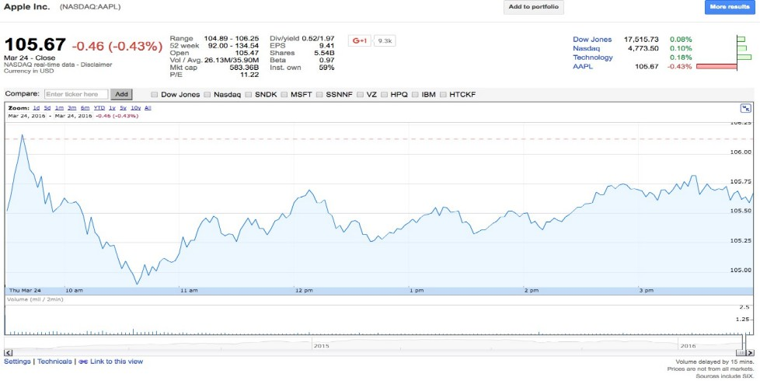
What can AI Systems Currently Do?
... predict stock price evolution, ...
38 / 39

Slide 123
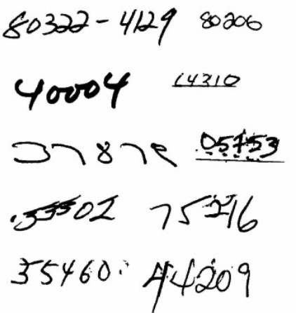
What can AI Systems Currently Do?
... understanding handwriting, ...
[LeCun et al. 1989]
38 / 39

Slide 124
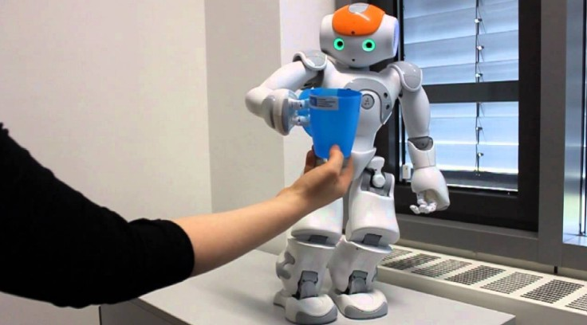
What can AI Systems Currently Do?
... learn to grab a cup, ...
http://www.informatik.uni-bremen.de/
38 / 39

Slide 125
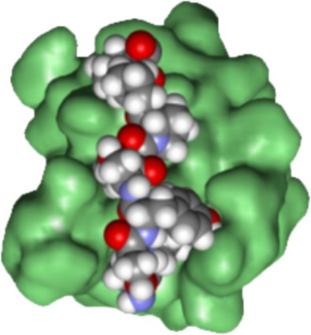
What can AI Systems Currently Do?
... design a molecule with given properties, ...
http://pande.stanford.edu/
38 / 39

Slide 126

What can AI Systems Currently Do?
... translate text from Chinese to English, ...
Oc Google Inc.
38 / 39

Slide 127

What can AI Systems Currently Do?
... convert a voice into text, ...
38 / 39

Slide 128
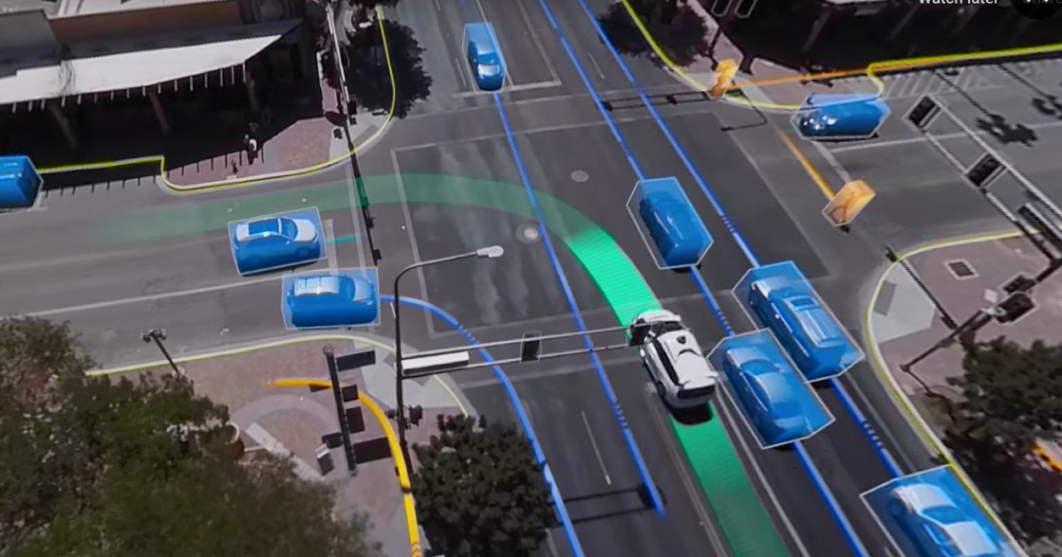
What can AI Systems Currently Do?
... predict traffic trajectories, ...
38 / 39

Slide 129
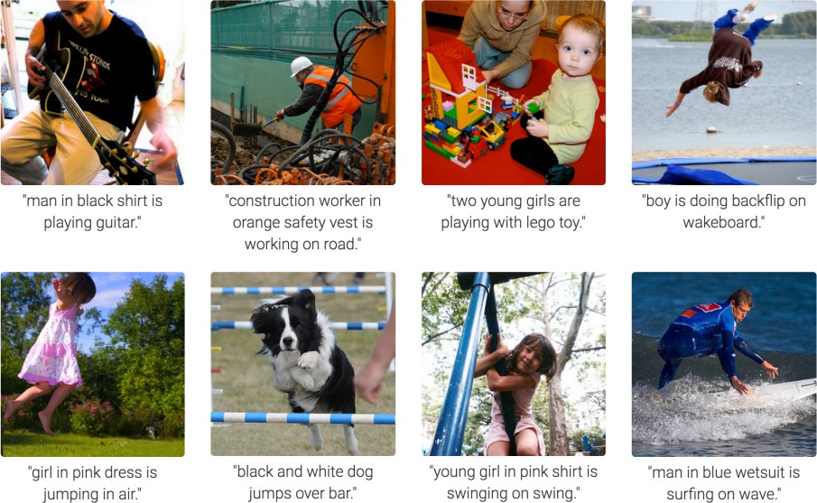
What can AI Systems Currently Do?
... automatically writing the caption of a figure, ...
[Karpathy & Fei-Fei, 2015; Donahue et al., 2015; Xu et al, 2015;...]
38 / 39

Slide 130
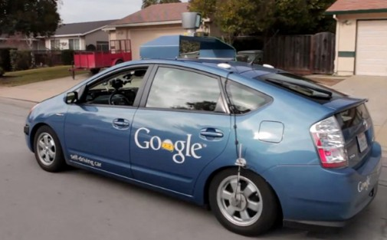
What can AI Systems Currently Do?
... driving autonomously, ...
Oc Google Inc.
38 / 39

Slide 131
What can AI Systems Currently Do?
... run & jump on two legs, ...
Oc Boston Dynamics
38 / 39

Slide 132
... beat a top-gun pilot in a simulated F16 dogfight, ...
What can AI Systems Currently Do?
38 / 39

Slide 133
Quiz: What can AI Systems Currently Do?
Play a decent game of Jeopardy? Win against any human at chess? Win against the best humans at Go? Play a decent game of tennis?
Grab a particular cup and put it on a shelf? Unload any dishwasher in any home?
Drive safely along the highway?
Drive safely in Naples’ center on rush hour? Buy groceries on the web?
Buy groceries at next corner shop?
Discover and prove a new mathematical theorem? Perform a surgical operation?
YES YES YES YES YES NO YES NO YES NO NO NO
Translate spoken Chinese into spoken English in real time? YES Write an intentionally funny story? NO
39 / 39

Slide 134
Quiz: What can AI Systems Currently Do?
Play a decent game of Jeopardy? Win against any human at chess? Win against the best humans at Go? Play a decent game of tennis?
Grab a particular cup and put it on a shelf? Unload any dishwasher in any home?
Drive safely along the highway?
Drive safely in Naples’ center on rush hour? Buy groceries on the web?
Buy groceries at next corner shop?
Discover and prove a new mathematical theorem? Perform a surgical operation?
YES YES YES YES YES NO YES NO YES NO NO NO
Translate spoken Chinese into spoken English in real time? YES Write an intentionally funny story? NO
39 / 39

Slide 135
Quiz: What can AI Systems Currently Do?
Play a decent game of Jeopardy? Win against any human at chess? Win against the best humans at Go? Play a decent game of tennis?
Grab a particular cup and put it on a shelf? Unload any dishwasher in any home?
Drive safely along the highway?
Drive safely in Naples’ center on rush hour? Buy groceries on the web?
Buy groceries at next corner shop?
Discover and prove a new mathematical theorem? Perform a surgical operation?
YES YES YES YES YES NO YES NO YES NO NO NO
Translate spoken Chinese into spoken English in real time? YES Write an intentionally funny story? NO
39 / 39

Slide 136
Quiz: What can AI Systems Currently Do?
Play a decent game of Jeopardy? Win against any human at chess? Win against the best humans at Go? Play a decent game of tennis?
Grab a particular cup and put it on a shelf? Unload any dishwasher in any home?
Drive safely along the highway?
Drive safely in Naples’ center on rush hour? Buy groceries on the web?
Buy groceries at next corner shop?
Discover and prove a new mathematical theorem? Perform a surgical operation?
YES YES YES YES YES NO YES NO YES NO NO NO
Translate spoken Chinese into spoken English in real time? YES Write an intentionally funny story? NO
39 / 39

Slide 137
Quiz: What can AI Systems Currently Do?
Play a decent game of Jeopardy? Win against any human at chess? Win against the best humans at Go? Play a decent game of tennis?
Grab a particular cup and put it on a shelf? Unload any dishwasher in any home?
Drive safely along the highway?
Drive safely in Naples’ center on rush hour? Buy groceries on the web?
Buy groceries at next corner shop?
Discover and prove a new mathematical theorem? Perform a surgical operation?
YES YES YES YES YES NO YES NO YES NO NO NO
Translate spoken Chinese into spoken English in real time? YES Write an intentionally funny story? NO
39 / 39

Slide 138
Quiz: What can AI Systems Currently Do?
Play a decent game of Jeopardy? Win against any human at chess? Win against the best humans at Go? Play a decent game of tennis?
Grab a particular cup and put it on a shelf? Unload any dishwasher in any home?
Drive safely along the highway?
Drive safely in Naples’ center on rush hour? Buy groceries on the web?
Buy groceries at next corner shop?
Discover and prove a new mathematical theorem? Perform a surgical operation?
YES YES YES YES YES NO YES NO YES NO NO NO
Translate spoken Chinese into spoken English in real time? YES Write an intentionally funny story? NO
39 / 39

Slide 139
Quiz: What can AI Systems Currently Do?
Play a decent game of Jeopardy? Win against any human at chess? Win against the best humans at Go? Play a decent game of tennis?
Grab a particular cup and put it on a shelf? Unload any dishwasher in any home?
Drive safely along the highway?
Drive safely in Naples’ center on rush hour? Buy groceries on the web?
Buy groceries at next corner shop?
Discover and prove a new mathematical theorem? Perform a surgical operation?
YES YES YES YES YES NO YES NO YES NO NO NO
Translate spoken Chinese into spoken English in real time? YES Write an intentionally funny story? NO
39 / 39

Slide 140
Quiz: What can AI Systems Currently Do?
Play a decent game of Jeopardy? Win against any human at chess? Win against the best humans at Go? Play a decent game of tennis?
Grab a particular cup and put it on a shelf? Unload any dishwasher in any home?
Drive safely along the highway?
Drive safely in Naples’ center on rush hour? Buy groceries on the web?
Buy groceries at next corner shop?
Discover and prove a new mathematical theorem? Perform a surgical operation?
YES YES YES YES YES NO YES NO YES NO NO NO
Translate spoken Chinese into spoken English in real time? YES Write an intentionally funny story? NO
39 / 39

Slide 141
Quiz: What can AI Systems Currently Do?
Play a decent game of Jeopardy? Win against any human at chess? Win against the best humans at Go? Play a decent game of tennis?
Grab a particular cup and put it on a shelf? Unload any dishwasher in any home?
Drive safely along the highway?
Drive safely in Naples’ center on rush hour? Buy groceries on the web?
Buy groceries at next corner shop?
Discover and prove a new mathematical theorem? Perform a surgical operation?
YES YES YES YES YES NO YES NO YES NO NO NO
Translate spoken Chinese into spoken English in real time? YES Write an intentionally funny story? NO
39 / 39

Slide 142
Quiz: What can AI Systems Currently Do?
Play a decent game of Jeopardy? Win against any human at chess? Win against the best humans at Go? Play a decent game of tennis?
Grab a particular cup and put it on a shelf? Unload any dishwasher in any home?
Drive safely along the highway?
Drive safely in Naples’ center on rush hour? Buy groceries on the web?
Buy groceries at next corner shop?
Discover and prove a new mathematical theorem? Perform a surgical operation?
YES YES YES YES YES NO YES NO YES NO NO NO
Translate spoken Chinese into spoken English in real time? YES Write an intentionally funny story? NO
39 / 39

Slide 143
Quiz: What can AI Systems Currently Do?
Play a decent game of Jeopardy? Win against any human at chess? Win against the best humans at Go? Play a decent game of tennis?
Grab a particular cup and put it on a shelf? Unload any dishwasher in any home?
Drive safely along the highway?
Drive safely in Naples’ center on rush hour? Buy groceries on the web?
Buy groceries at next corner shop?
Discover and prove a new mathematical theorem? Perform a surgical operation?
YES YES YES YES YES NO YES NO YES NO NO NO
Translate spoken Chinese into spoken English in real time? YES Write an intentionally funny story? NO
39 / 39

Slide 144
Quiz: What can AI Systems Currently Do?
Play a decent game of Jeopardy? Win against any human at chess? Win against the best humans at Go? Play a decent game of tennis?
Grab a particular cup and put it on a shelf? Unload any dishwasher in any home?
Drive safely along the highway?
Drive safely in Naples’ center on rush hour? Buy groceries on the web?
Buy groceries at next corner shop?
Discover and prove a new mathematical theorem? Perform a surgical operation?
YES YES YES YES YES NO YES NO YES NO NO NO
Translate spoken Chinese into spoken English in real time? YES Write an intentionally funny story? NO
39 / 39

Slide 145
Quiz: What can AI Systems Currently Do?
Play a decent game of Jeopardy? Win against any human at chess? Win against the best humans at Go? Play a decent game of tennis?
Grab a particular cup and put it on a shelf? Unload any dishwasher in any home?
Drive safely along the highway?
Drive safely in Naples’ center on rush hour? Buy groceries on the web?
Buy groceries at next corner shop?
Discover and prove a new mathematical theorem? Perform a surgical operation?
YES YES YES YES YES NO YES NO YES NO NO NO
Translate spoken Chinese into spoken English in real time? YES Write an intentionally funny story? NO
39 / 39

Slide 146
Quiz: What can AI Systems Currently Do?
Play a decent game of Jeopardy? Win against any human at chess? Win against the best humans at Go? Play a decent game of tennis?
Grab a particular cup and put it on a shelf? Unload any dishwasher in any home?
Drive safely along the highway?
Drive safely in Naples’ center on rush hour? Buy groceries on the web?
Buy groceries at next corner shop?
Discover and prove a new mathematical theorem? Perform a surgical operation?
YES YES YES YES YES NO YES NO YES NO NO NO
Translate spoken Chinese into spoken English in real time? YES Write an intentionally funny story? NO
39 / 39

Slide 147
Quiz: What can AI Systems Currently Do?
Play a decent game of Jeopardy? Win against any human at chess? Win against the best humans at Go? Play a decent game of tennis?
Grab a particular cup and put it on a shelf? Unload any dishwasher in any home?
Drive safely along the highway?
Drive safely in Naples’ center on rush hour? Buy groceries on the web?
Buy groceries at next corner shop?
Discover and prove a new mathematical theorem? Perform a surgical operation?
YES YES YES YES YES NO YES NO YES NO NO NO
Translate spoken Chinese into spoken English in real time? YES Write an intentionally funny story? NO
39 / 39

Slide 148
Quiz: What can AI Systems Currently Do?
Play a decent game of Jeopardy? Win against any human at chess? Win against the best humans at Go? Play a decent game of tennis?
Grab a particular cup and put it on a shelf? Unload any dishwasher in any home?
Drive safely along the highway?
Drive safely in Naples’ center on rush hour? Buy groceries on the web?
Buy groceries at next corner shop?
Discover and prove a new mathematical theorem? Perform a surgical operation?
YES YES YES YES YES NO YES NO YES NO NO NO
Translate spoken Chinese into spoken English in real time? YES Write an intentionally funny story? NO
39 / 39

Slide 149
Quiz: What can AI Systems Currently Do?
Play a decent game of Jeopardy? Win against any human at chess? Win against the best humans at Go? Play a decent game of tennis?
Grab a particular cup and put it on a shelf? Unload any dishwasher in any home?
Drive safely along the highway?
Drive safely in Naples’ center on rush hour? Buy groceries on the web?
Buy groceries at next corner shop?
Discover and prove a new mathematical theorem? Perform a surgical operation?
YES YES YES YES YES NO YES NO YES NO NO NO
Translate spoken Chinese into spoken English in real time? YES Write an intentionally funny story? NO
39 / 39

Slide 150
Quiz: What can AI Systems Currently Do?
Play a decent game of Jeopardy? Win against any human at chess? Win against the best humans at Go? Play a decent game of tennis?
Grab a particular cup and put it on a shelf? Unload any dishwasher in any home?
Drive safely along the highway?
Drive safely in Naples’ center on rush hour? Buy groceries on the web?
Buy groceries at next corner shop?
Discover and prove a new mathematical theorem? Perform a surgical operation?
YES YES YES YES YES NO YES NO YES NO NO NO
Translate spoken Chinese into spoken English in real time? YES Write an intentionally funny story? NO
39 / 39

Slide 151
Quiz: What can AI Systems Currently Do?
Play a decent game of Jeopardy? Win against any human at chess? Win against the best humans at Go? Play a decent game of tennis?
Grab a particular cup and put it on a shelf? Unload any dishwasher in any home?
Drive safely along the highway?
Drive safely in Naples’ center on rush hour? Buy groceries on the web?
Buy groceries at next corner shop?
Discover and prove a new mathematical theorem? Perform a surgical operation?
YES YES YES YES YES NO YES NO YES NO NO NO
Translate spoken Chinese into spoken English in real time? YES Write an intentionally funny story? NO
39 / 39

Slide 152
Quiz: What can AI Systems Currently Do?
Play a decent game of Jeopardy? Win against any human at chess? Win against the best humans at Go? Play a decent game of tennis?
Grab a particular cup and put it on a shelf? Unload any dishwasher in any home?
Drive safely along the highway?
Drive safely in Naples’ center on rush hour? Buy groceries on the web?
Buy groceries at next corner shop?
Discover and prove a new mathematical theorem? Perform a surgical operation?
YES YES YES YES YES NO YES NO YES NO NO NO
Translate spoken Chinese into spoken English in real time? YES Write an intentionally funny story? NO
39 / 39

Slide 153
Quiz: What can AI Systems Currently Do?
Play a decent game of Jeopardy? Win against any human at chess? Win against the best humans at Go? Play a decent game of tennis?
Grab a particular cup and put it on a shelf? Unload any dishwasher in any home?
Drive safely along the highway?
Drive safely in Naples’ center on rush hour? Buy groceries on the web?
Buy groceries at next corner shop?
Discover and prove a new mathematical theorem? Perform a surgical operation?
YES YES YES YES YES NO YES NO YES NO NO NO
Translate spoken Chinese into spoken English in real time? YES Write an intentionally funny story? NO
39 / 39

Slide 154
Quiz: What can AI Systems Currently Do?
Play a decent game of Jeopardy? Win against any human at chess? Win against the best humans at Go? Play a decent game of tennis?
Grab a particular cup and put it on a shelf? Unload any dishwasher in any home?
Drive safely along the highway?
Drive safely in Naples’ center on rush hour? Buy groceries on the web?
Buy groceries at next corner shop?
Discover and prove a new mathematical theorem? Perform a surgical operation?
YES YES YES YES YES NO YES NO YES NO NO NO
Translate spoken Chinese into spoken English in real time? YES Write an intentionally funny story? NO
39 / 39

Slide 155
Quiz: What can AI Systems Currently Do?
Play a decent game of Jeopardy? Win against any human at chess? Win against the best humans at Go? Play a decent game of tennis?
Grab a particular cup and put it on a shelf? Unload any dishwasher in any home?
Drive safely along the highway?
Drive safely in Naples’ center on rush hour? Buy groceries on the web?
Buy groceries at next corner shop?
Discover and prove a new mathematical theorem? Perform a surgical operation?
YES YES YES YES YES NO YES NO YES NO NO NO
Translate spoken Chinese into spoken English in real time? YES Write an intentionally funny story? NO
39 / 39

Slide 156
Quiz: What can AI Systems Currently Do?
Play a decent game of Jeopardy? Win against any human at chess? Win against the best humans at Go? Play a decent game of tennis?
Grab a particular cup and put it on a shelf? Unload any dishwasher in any home?
Drive safely along the highway?
Drive safely in Naples’ center on rush hour? Buy groceries on the web?
Buy groceries at next corner shop?
Discover and prove a new mathematical theorem? Perform a surgical operation?
YES YES YES YES YES NO YES NO YES NO NO NO
Translate spoken Chinese into spoken English in real time? YES Write an intentionally funny story? NO
39 / 39

Slide 157
Quiz: What can AI Systems Currently Do?
Play a decent game of Jeopardy? Win against any human at chess? Win against the best humans at Go? Play a decent game of tennis?
Grab a particular cup and put it on a shelf? Unload any dishwasher in any home?
Drive safely along the highway?
Drive safely in Naples’ center on rush hour? Buy groceries on the web?
Buy groceries at next corner shop?
Discover and prove a new mathematical theorem? Perform a surgical operation?
YES YES YES YES YES NO YES NO YES NO NO NO
Translate spoken Chinese into spoken English in real time? YES Write an intentionally funny story? NO
39 / 39

Slide 158
Quiz: What can AI Systems Currently Do?
Play a decent game of Jeopardy? Win against any human at chess? Win against the best humans at Go? Play a decent game of tennis?
Grab a particular cup and put it on a shelf? Unload any dishwasher in any home?
Drive safely along the highway?
Drive safely in Naples’ center on rush hour? Buy groceries on the web?
Buy groceries at next corner shop?
Discover and prove a new mathematical theorem? Perform a surgical operation?
YES YES YES YES YES NO YES NO YES NO NO NO
Translate spoken Chinese into spoken English in real time? YES Write an intentionally funny story? NO
39 / 39

Slide 159
Quiz: What can AI Systems Currently Do?
Play a decent game of Jeopardy? Win against any human at chess? Win against the best humans at Go? Play a decent game of tennis?
Grab a particular cup and put it on a shelf? Unload any dishwasher in any home?
Drive safely along the highway?
Drive safely in Naples’ center on rush hour? Buy groceries on the web?
Buy groceries at next corner shop?
Discover and prove a new mathematical theorem? Perform a surgical operation?
YES YES YES YES YES NO YES NO YES NO NO NO
Translate spoken Chinese into spoken English in real time? YES Write an intentionally funny story? NO
39 / 39

Slide 160
Quiz: What can AI Systems Currently Do?
Play a decent game of Jeopardy? Win against any human at chess? Win against the best humans at Go? Play a decent game of tennis?
Grab a particular cup and put it on a shelf? Unload any dishwasher in any home?
Drive safely along the highway?
Drive safely in Naples’ center on rush hour? Buy groceries on the web?
Buy groceries at next corner shop?
Discover and prove a new mathematical theorem? Perform a surgical operation?
YES YES YES YES YES NO YES NO YES NO NO NO
Translate spoken Chinese into spoken English in real time? YES Write an intentionally funny story? NO
39 / 39

